Slide 1
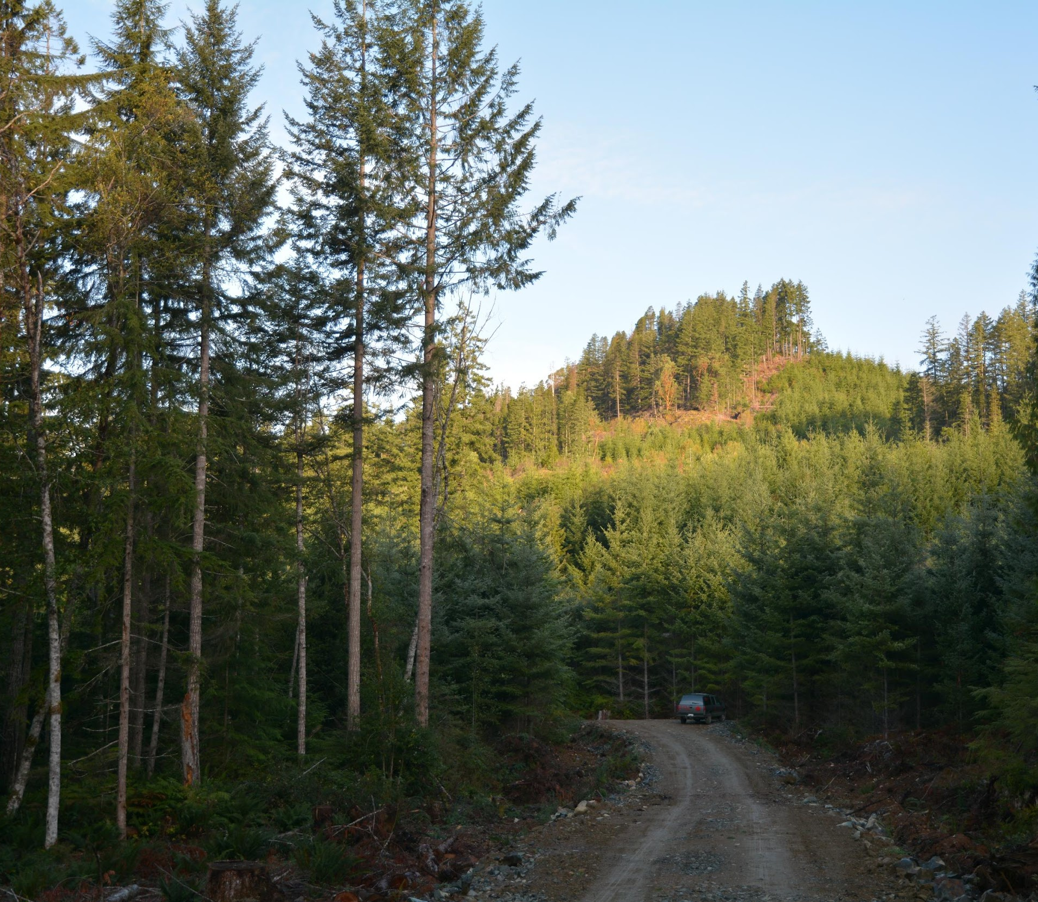
Basic Incident Investigation
Training
Version: January 9, 2024
BC Forest Safety
1
Notes:
Slide that shows while the participants are opening the course.

Slide 2
Welcome
[Trainer Name]
Contact Information:
[Phone Number]
[Email]
BC Forest Safety
2
Notes:
Give them your name and contact information, and let them know how they can contact you afterwards.
Let them know you will talk a bit more about your background shortly.

Slide 3
Acknowledgement
We respectfully acknowledge these unceded ancestral lands, upon which we live, work and play.
We are honoured to have the opportunity to engage and work with First Nations, Inuit and Métis across B.C.
BC Forest Safety
3
Notes:
Read out the general land acknowledgement.
If you know the name of the First Nation where you and the participants are located, make sure to acknowledge those nations.

Slide 4
Section 1 – Course Overview
Site Safety Plan/Briefing
This is a safety related course. What do we need to know about and pay attention to during this workshop?
Evacuation Plan
Safe Assembly/Muster Point
First Aid/Fire Equipment
Call “9-1-1”
Any hazards?
BC Forest Safety
Notes:
Essentially an ERP briefing for the workshop/classroom space.

Slide 5
Section 1 – Course Overview
Overview
Timing and breaks
Afternoon – Investigation practice
Participation and Confidentiality
Washrooms
Cell phones
Sign-in form
Indicates page # in Participant Manual
Indicates an activity page number in the Trainer’s Manual
#
#
BC Forest Safety
Notes:
Review logistics so participants know what to expect.
Mention the importance of participation.
Ask them to be sure to minimize interruptions and fully focus on the day (turn off cell phones, etc.).

Slide 6
Section 1 – Course Overview
Introductions
What’s your name?
What company do you work for and what is your position?
Have you been involved with investigating incidents before?
What do you hope to get from this course?
14
04
BC Forest Safety
6
Notes:
Facilitate introductions
Talk about and review the layout/organization of the Participant Manual
Introduce yourself

Slide 7
Section 1 – Course Overview
Objectives
When you complete this course, you will be able to:
Discuss the reasons for and value of conducting incident investigations
Prepare for and conduct effective incident investigations
Identify the causes of incidents
Develop effective corrective actions
Follow up on the results of investigation corrective actions
15
04
BC Forest Safety
Notes:
Review the course objectives

Slide 8
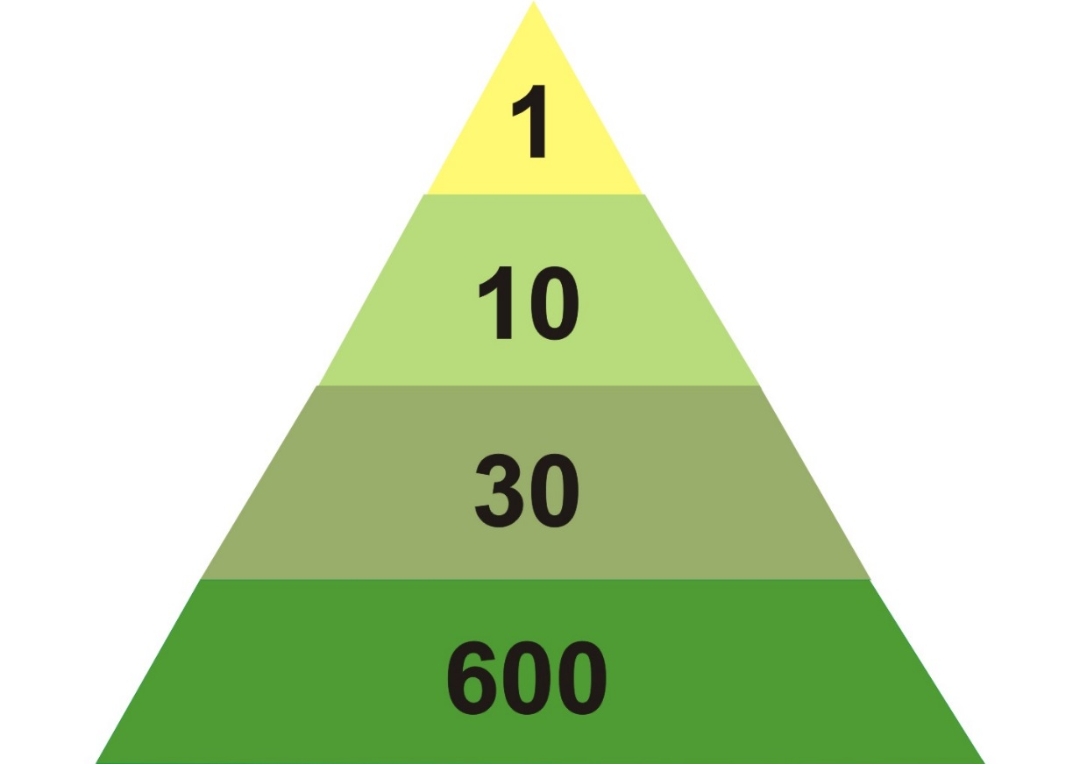
Section 2 – The Why of Investigation
Investigate All Incidents
Serious incidents are built on a foundation of less severe incidents.
Serious or Major Incident
Minor Incidents
Property Damage Incidents
Close Call Incidents
Bird & Germain (1966). Based on a variety of industries.
16
05
BC Forest Safety
Notes:
Explain the safety pyramid concept; how the specifics vary from industry to industry.
Talk about how investigation of all incidents should be focused on what happened, not laying blame. Laying blame reduces the reporting of incidents.

Slide 9
Section 2 – The Why of Investigation
Doing What’s Right is Good for Business
Video “Homecomings” – WorkSafe Victoria (Australia)
19
BC Forest Safety
Notes:
Explain that you will be discussing how doing the right thing is what’s good for business – exploring ethical / moral / reasons of conscience and financial reasons.
Play the video: “Homecomings” (Time 0:60) – WorkSafe Victoria (Australia) Longer version: https://youtu.be/m64TxQdBieI

Slide 10
Section 2 – The Why of Investigation
Doing What’s Right
Group Activity: Brainstorm
What are some of the reasons that make conducting incident investigations the ‘right’ thing to do?
Incident prevention
Family
Integrity
Safety attitude
Mental wellness
Closure
19
06
BC Forest Safety
Notes:
Ask participants why conducting incident investigations is the ‘right’ thing to do.
Record ideas and suggestions on flipchart, whiteboard or chalkboard.
They can write their answers in the PARTICIPANT MANUAL.

Slide 11
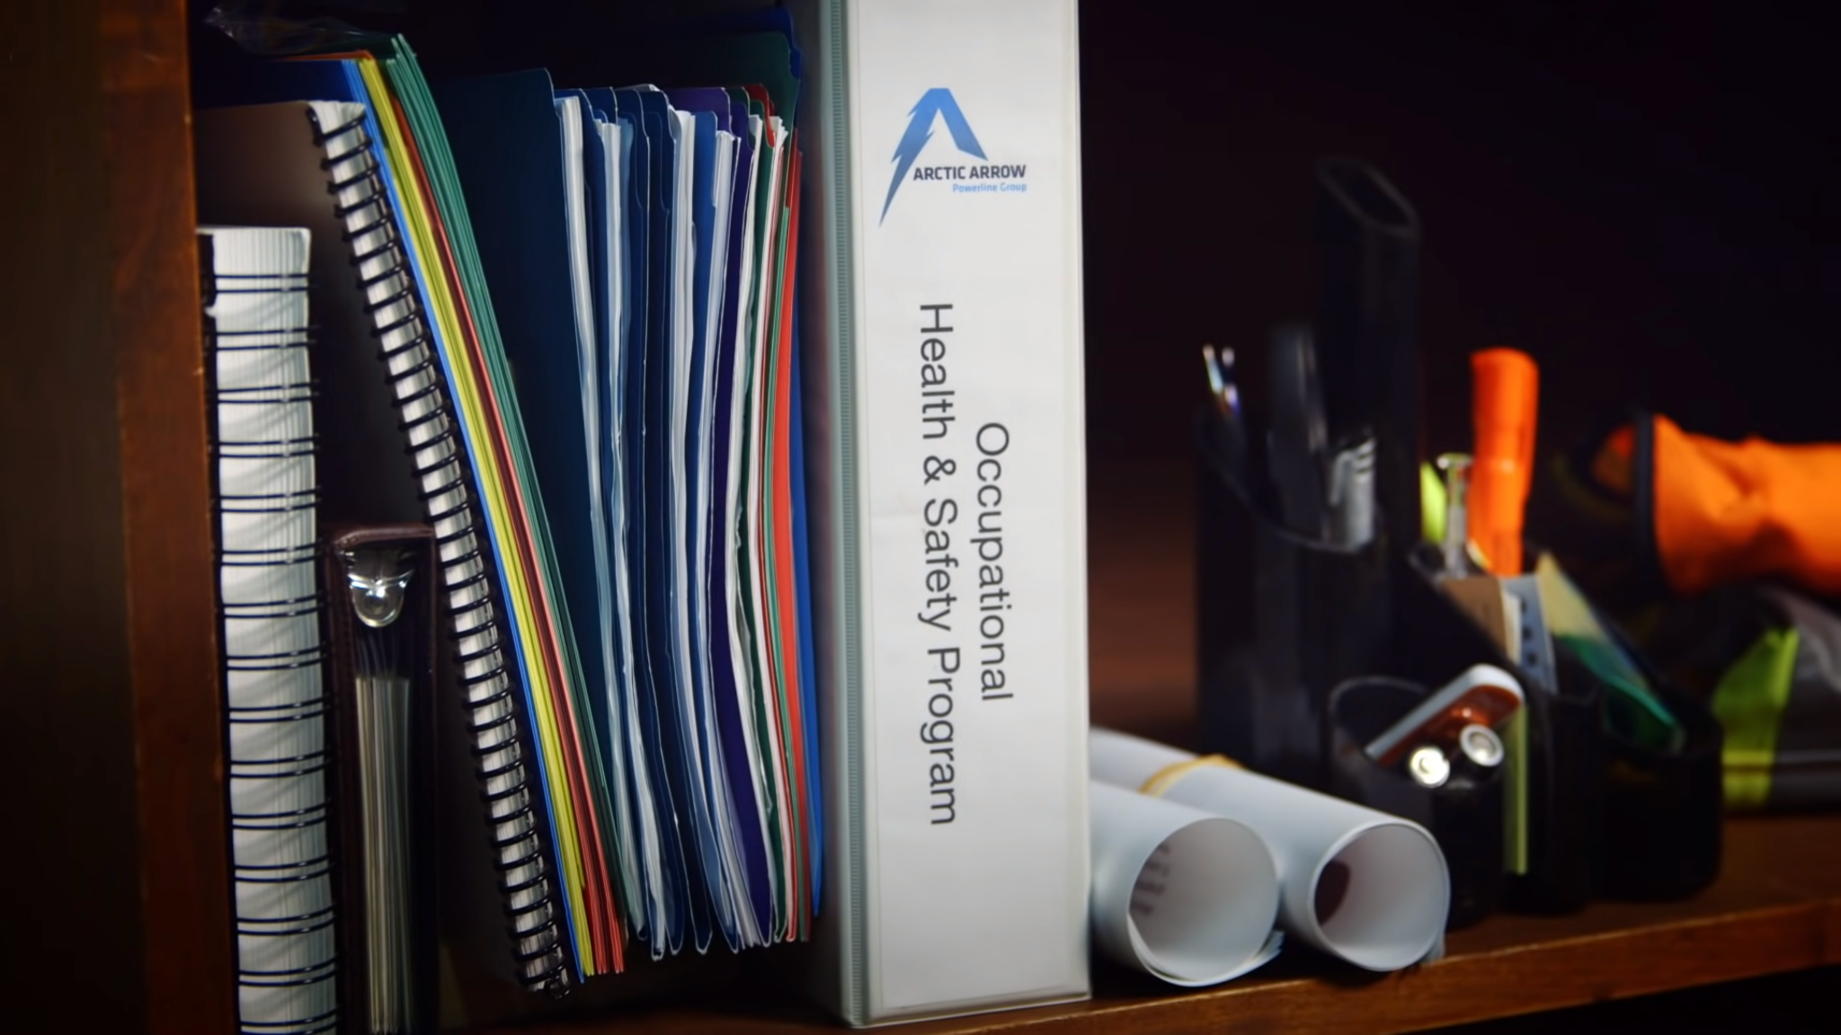
Section 2 – The Why of Investigation
Doing What’s Right
Video - Safety is Personal: An Employers Story
20
07
BC Forest Safety
Notes:
Safety is Personal; An Employers Story
https://youtu.be/x9WthTBEKsw
Review key points
Serious incidents create unease among workers, families and the community.
Safety programs are only helpful when actions are taken to enact them.

Slide 12
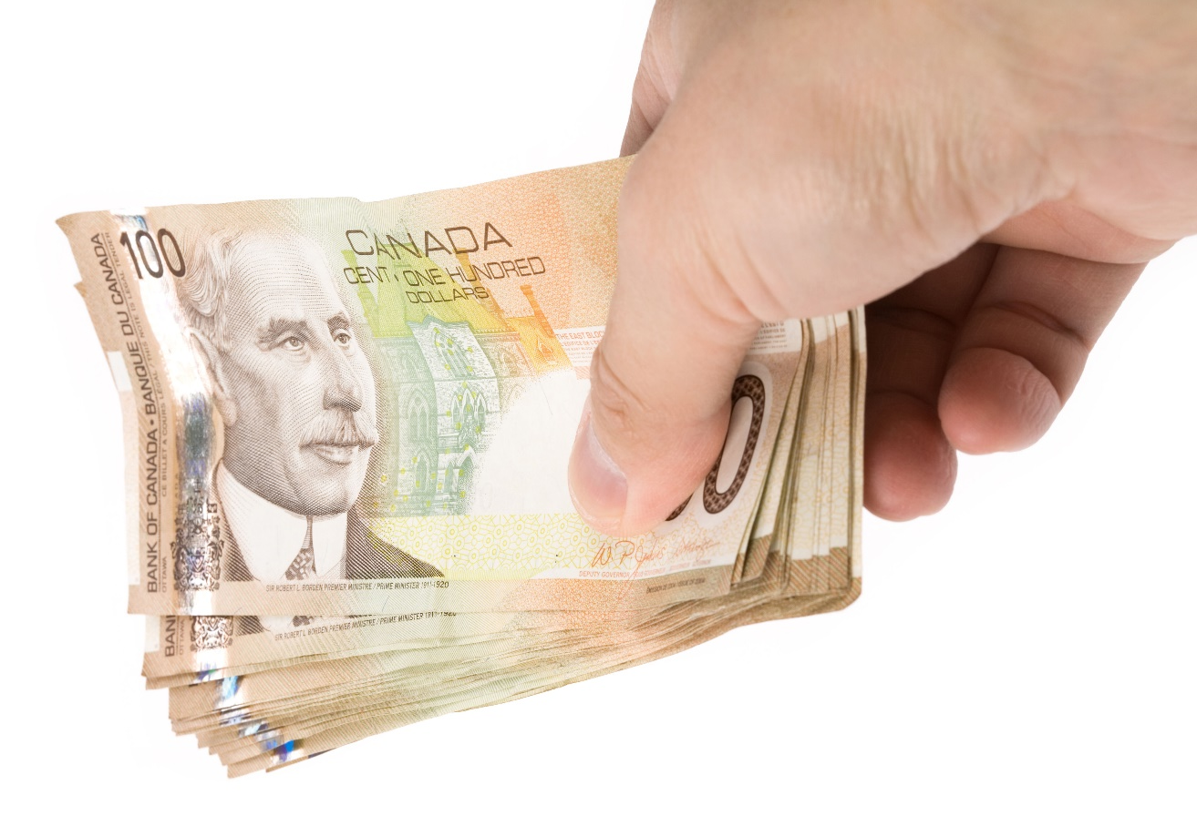
Section 2 – The Why of Investigation
Doing What’s Good for Business
Group Activity: Brainstorm
What are the business costs of incidents?
21
08
BC Forest Safety
Notes:
In the large group, have your participants brainstorm the many costs of incidents.
They can write their thoughts in the PARTICIPANT MANUAL.

Slide 13
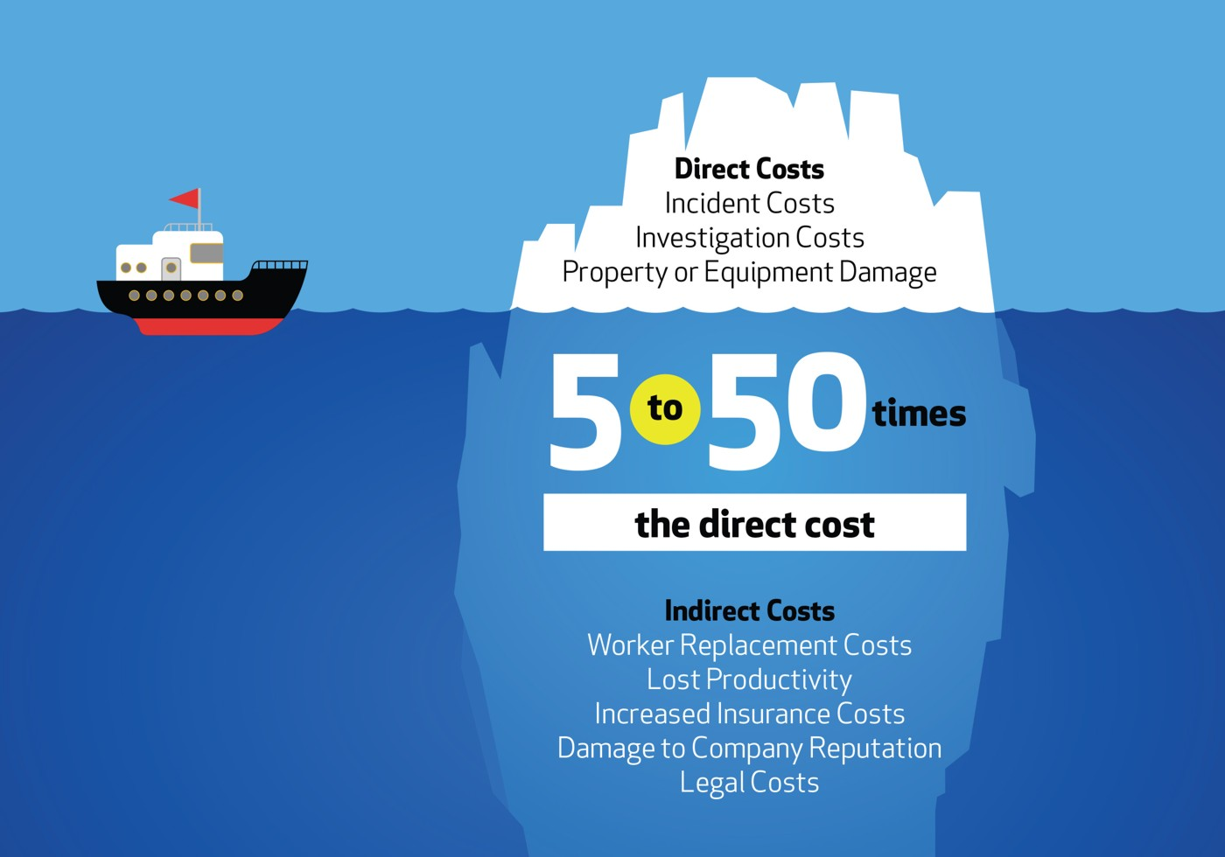
Section 2 – The Why of Investigation
Doing What’s Good for Business
22
09
BC Forest Safety
Notes:
Explain the differences between direct and indirect costs.
Point out the handout on direct and indirect costs in the PARTICIPANT MANUAL.

Slide 14
Section 2 – The Why of Investigation
Doing What’s Good for Business
How Claims affect WorkSafe BC Ratings and Premiums
Reduced Injury Claims Costs
Improved Experience Rating
Lower WorkSafeBC Premiums
Example:
55-year-old worker was repairing a tire
The tire exploded
He had to go on disability
He drew a 65% pension
He suffered; company paid high cost
25
10
BC Forest Safety
Notes:
Explain the fact that premiums are directly related to incidents and a company’s WorkSafeBC Premiums.
Review the story/example from the Trainer Manual

Slide 15
Section 2 – The Why of Investigation
Doing What’s Good for Business
 | Scenario 1 (few injuries) | Scenario 2 (many injuries)
Annual payroll | 100,000 | 100,000
Annual premium | -5,000 | -5,000
Max. merit of 50% annual premium payment | +2,500 | N/A
Max. demerit of 100% annual premium payment | N/A | -5,000
TOTAL PREMIUM (w/merit or demerits applied) | -2,500 | -10,000
Merit or demerit is determined by the average of your company’s claims costs in the past 3 years compared to the industry average.
26
10
BC Forest Safety
Notes:
Explain this example of implications of incidents to a company’s WorkSafeBC Premiums.

Slide 16
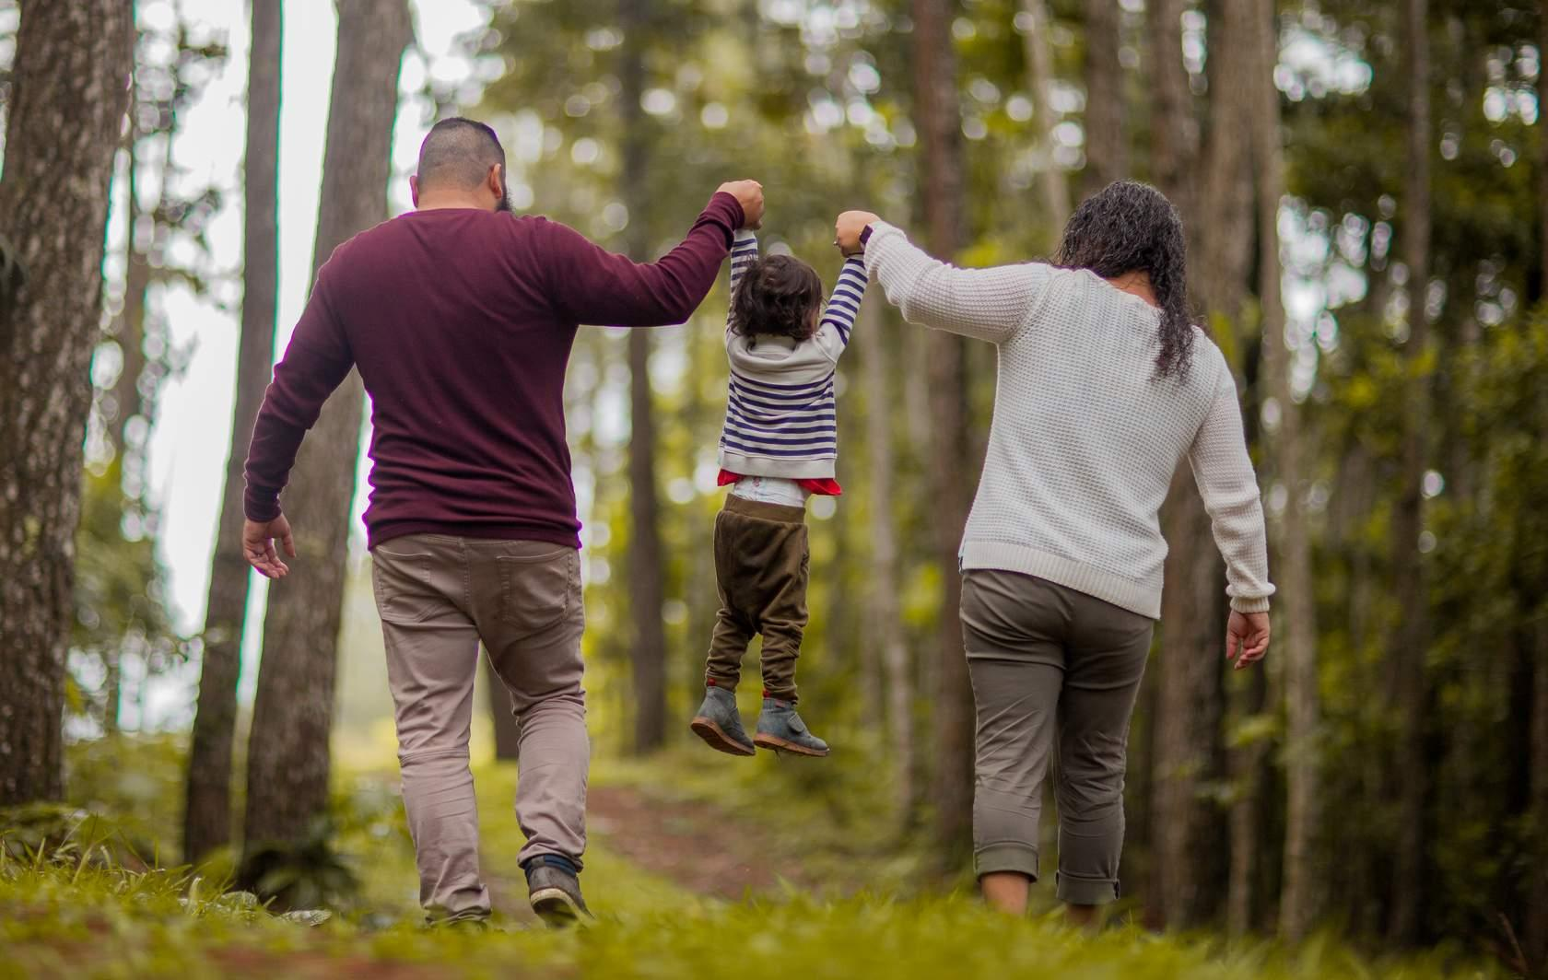
Section 2 – The Why of Investigation
Summary
The Why of Investigation
Doing what’s right is good for business
26
BC Forest Safety
Notes:
Summarize reasons for doing the right thing and doing what’s good for business.

Slide 17
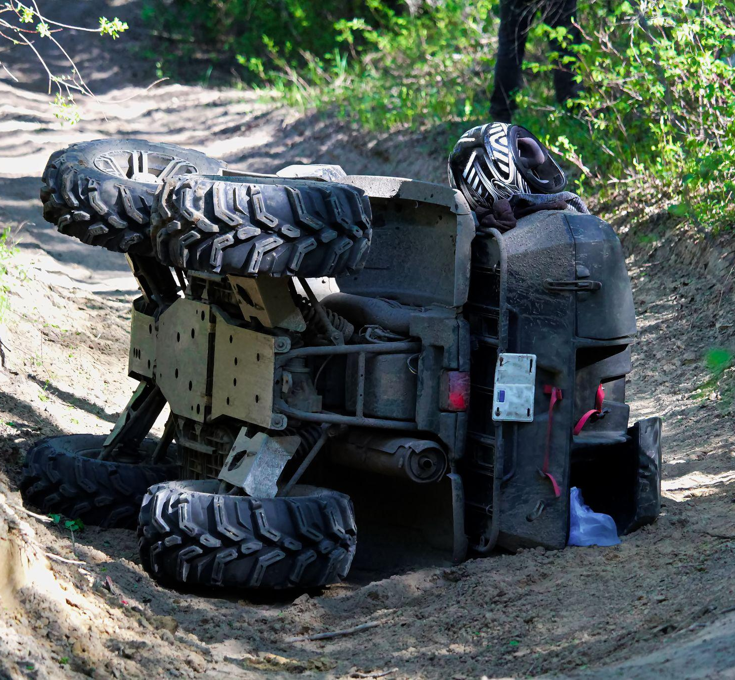
Section 3 – When to Investigate
Legal Obligations
Focus of this section:
WorkSafeBC requirements
What incidents must be reported
Determining what incidents must/should be investigated
27
BC Forest Safety
Notes:
Explain WorkSafeBC requirements.
Discuss/explain how incident reporting is different from incident investigations.

Slide 18
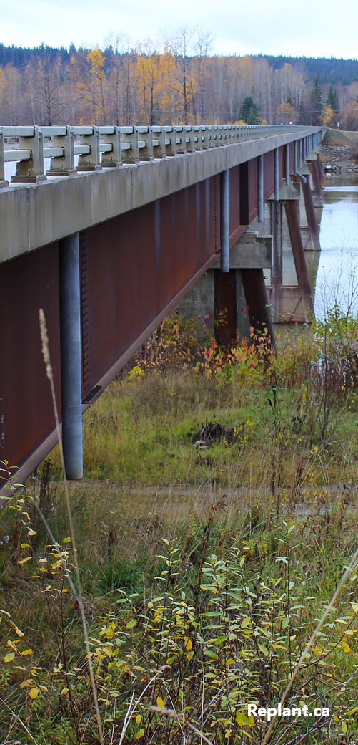
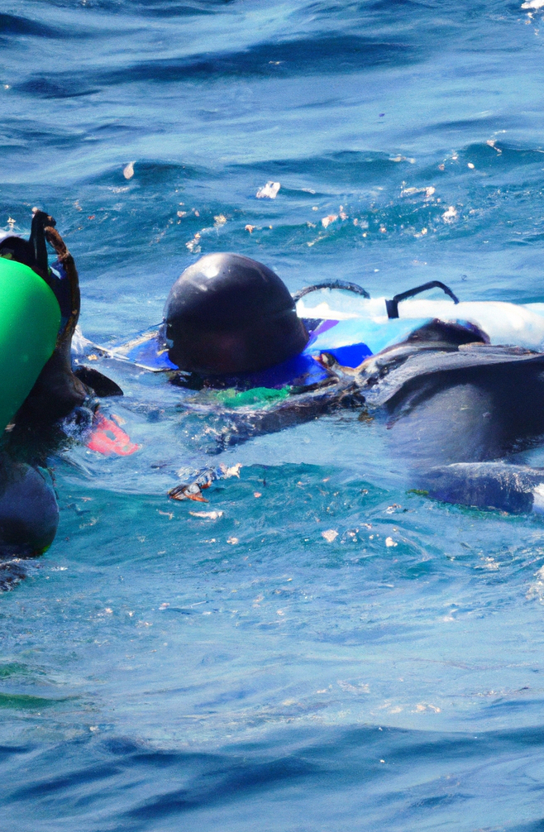
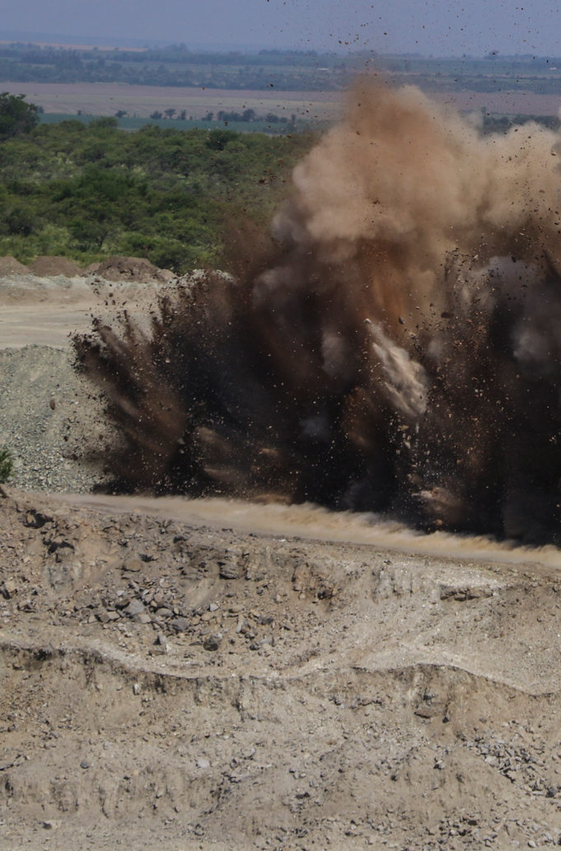
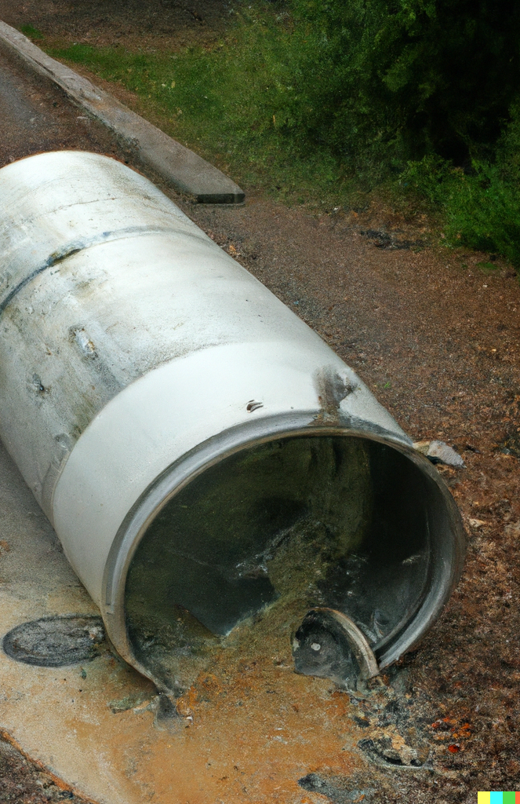
Section 3 – When to Investigate
What is Reportable to WorkSafeBC?
Under the Workers Compensation Act (Section 68)
IMMEDIATELY notify WorkSafeBC if:
Person is SERIOUSLY injured or killed
Major structural failure or collapse
Fire/Explosion incident (if risk to worker)
Major release of hazardous substance
By Regulation…
Blasting/Explosives related incident
11
Diving incident
31
11
BC Forest Safety
Notes:
Explain what is immediately reportable to WorkSafeBC
Point out and discuss OHS Guideline “G-P2-68-1 – WSBC Notification of Serious Injuries – April 6, 2020 in the Participant Manual and how it helps define what a serious injury is.

Slide 19
Section 3 – When to Investigate
Legislative and Regulatory Framework
Immediately notify WorkSafeBC once:
Immediate hazards are addressed
First aid and medical treatment provided for injured worker
Toll-free: 1-888-621-SAFE (7233)
28
15
BC Forest Safety
Notes:
Discuss the guideline definition of “Serious Injury” and “Immediately” – see Trainer’s Manual.
Point out the handout that’s available on serious injury:
[LINK: https://www.bcforestsafe.org/wp-content/uploads/2023/05/Serious-Injury-Fact-Sheet.Final_.pdf]

Slide 20
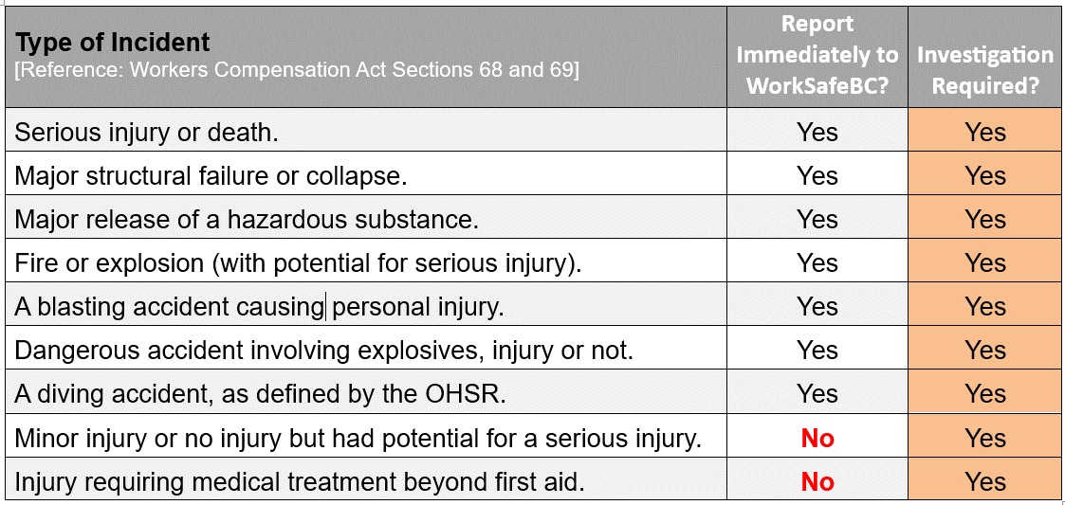
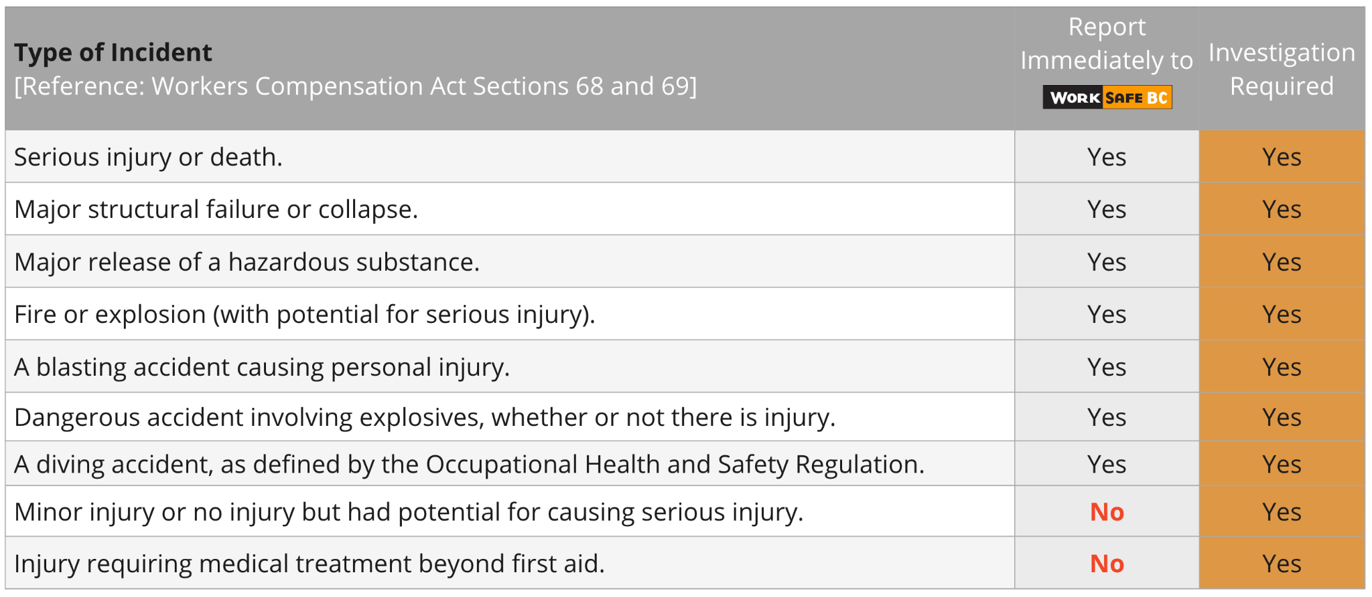
Section 4 – What to Investigate
Legislative and Regulatory Framework
29
16
BC Forest Safety
Notes:
The first column of the chart is a review of the types of incidents that must be immediately reported to WorkSafeBC.
Discuss how all 9 types of incidents must be investigated.

Slide 21
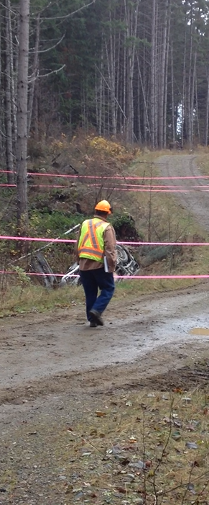
Section 4 – What to Investigate
Secure Incident Scene
Do not disturb the scene of a reportable incident.
Exceptions:
When directed by WorkSafeBC or peace officer
When attending to a person who is injured or killed
To prevent further injuries
To protect property that is endangered
29
15
BC Forest Safety

Slide 22
Section 4 – What to Investigate
Activity
Scenario 1: Minor or no injury with potential for serious injury
Scenario 2:Other close calls or minor incidents
Scenario 3: An incident that resulted in an injury to a worker requiring medical treatment
Should you investigate this or not?
How do you decide?
If the decision is not to investigate, what could/should you do instead?
31
16
BC Forest Safety
Notes:
After reviewing the chart, present and discuss the 3 example scenarios in the manual and how they relate to the types of incidents listed in the chart. For each scenario, ask your participants:
Should you investigate this, or not?
How do you decide?
If the decision is to not investigate, what could/should you do instead?
PARTICIPANT MANUAL: At the end of the discussion, give your participants a few minutes to answer the two summary questions in their manual (“How do I decide whether to investigate an incident? If I decide that an investigation is not required, what are other things I could do?”).

Slide 23
Section 4 – What to Investigate
Legislative and Regulatory Framework
Other legislation references that apply to specific situations:
Occupational Health and Safety Regulation – sections:
4.26 – Workplace Conduct: Improper Activity & Behaviour
4.30(3)(d) – Workplace Violence
21.13 – Blasting Incidents
24.34 – Diving Incidents
Other agencies may require reporting or investigation of incidents:
Technical Safety BC
Ministry of Environment and Transport Canada for certain spill incidents
34
18
BC Forest Safety
Notes:
Explain that there are a number of other legislation references that apply to specific situations.
Explain that there are other agencies that may require investigations.
PARTICIPANT MANUAL: A summary list of the legislative references is provided.

Slide 24
Section 3 – When to Investigate
Incident Investigation Requirements
Immediately
Within 48 hrs
Within 30 days
Ongoing
Workplace
Incident occurs
Contact WorkSafeBC if the incident requires notification
Complete preliminary investigation and prepare report
Complete full investigation and prepare report
Follow-up to ensure corrective action(s) is (are) in place and effective
WorkSafeBC may request
Submit full report to WorkSafeBC
Within 3 days
Complete corrective action(s) and prepare report
Complete corrective action(s) and prepare report
If a worker is injured, Employer and Employee must submit Form 7 – Report of Injury or Occupational Disease
Provide report to employees
Provide report to employees
Reports can be combined if the full investigation can be completed in 48 hours
34
17
BC Forest Safety
Notes:
Explain how this slide is a key focus of training – certain types of incidents require that WorkSafeBC is immediately notified, and that a preliminary investigation is completed with corrective actions within 48 hours and a full investigation with corrective actions is completed and submitted to WorkSafeBC within 30 days of the incident.
Explain that reporting an injury is different from submitting an investigation report and that they go to different departments in WorkSafeBC.
Explain that filing Form 7 to report an injury does not satisfy the need to immediately notify WorkSafeBC of incidents/injuries/fatalities.

Slide 25
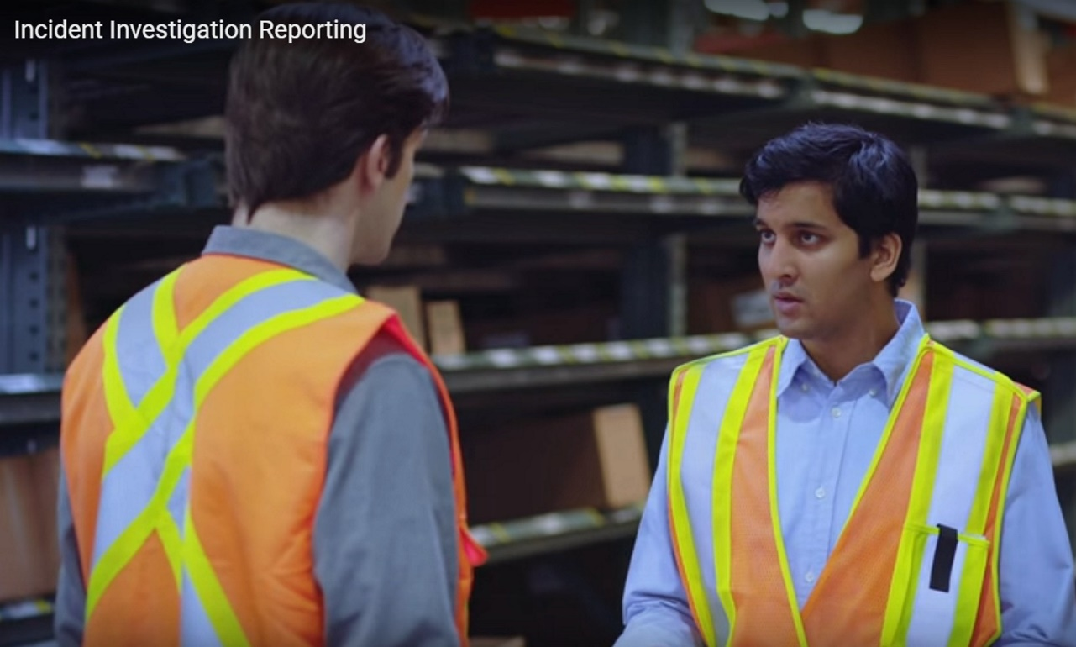
Section 4 – What to Investigate
Legislative & Regulatory Framework
Video – WorkSafeBC Incident Investigation Reporting
35
18
BC Forest Safety
Notes:
Show this video which outlines the requirements for preliminary investigation and interim corrective action (s175), and full investigation and full corrective action reporting (s176).
Incident Investigation Reporting
https://youtu.be/zPu2CePrHhc

Slide 26
Section 4 – What to Investigate
Legislative & Regulatory Framework
Employer Incident Investigation Report Form 52E40
https://www.worksafebc.com/en/resources/health-safety/forms/incident-investigation-report-form-52e40?lang=en
35
19
BC Forest Safety
Notes:
Explain the layout of the WorkSafeBC Employer Incident Investigation Report (EIIR Form 52E40). Walk through all 19 sections.
Mention that there are many different formats of incident investigation reports, but they all should contain the same basic information for reporting preliminary investigation findings and corrective actions, and full investigation findings and corrective actions.
Compare your form to the WorkSafeBC form.
Mention that more time will be provided in the afternoon to work with the EIIR form in the case study practice exercises.

Slide 27
Section 4 – What to Investigate
Legislative & Regulatory Framework
Full Employer
Incident Investigation
Reports can be
submitted:
Online
By FAX
By mail
Do not contact your local WorkSafeBC office.
https://eiirupload.online.worksafebc.com/
36
19
BC Forest Safety
Notes:
Explain how WorkSafeBC may request that a Preliminary Investigation report be filed.
All Full Investigation and Corrective Action reports must be submitted to WorkSafeBC by secure website, or FAX (yes, FAX), or by mail to WorkSafeBC.
Click on the EIIR Upload screen link above to launch the website.
https://eiirupload.online.worksafebc.com/

Slide 28
Section 4 – What to Investigate
HR Investigations
Human Resources Investigations vs Incident Investigations
HR Investigations:
Confidential
Focus on discrimination, violence, or harassment
Often initiated by employees
Incident Investigations:
Shared with employees
Focus on identifying underlying causes, factors and circumstances so similar incidents can be prevented in the future
36
BC Forest Safety
Notes:
Compare HR Investigations to Incident Investigations.

Slide 29
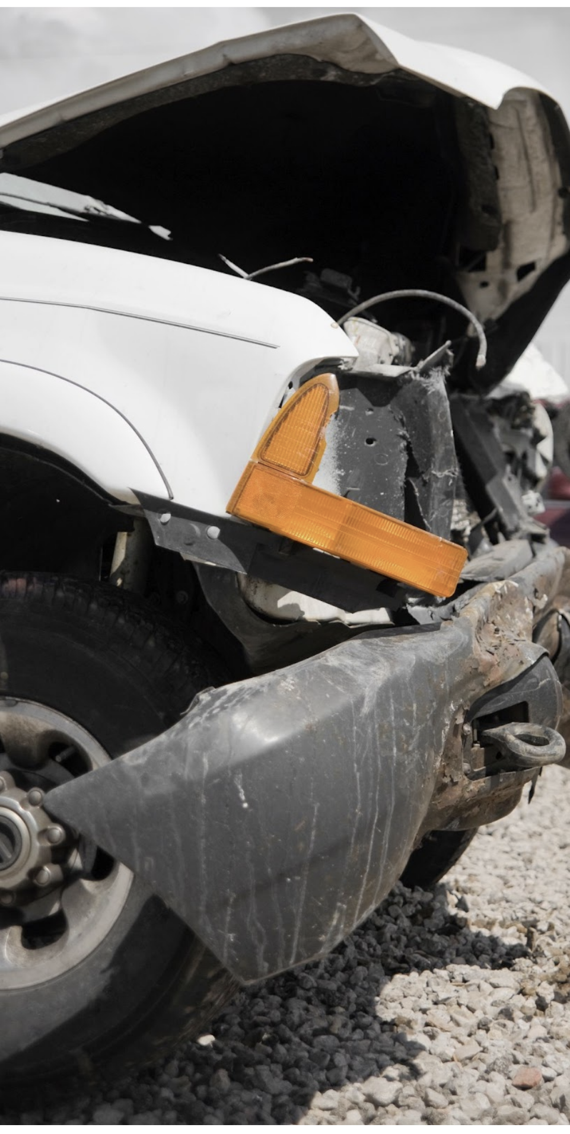
Section 4 – What to Investigate
Summary: Legislation & Regulations
After incident occurs, what needs to happen:
Immediately?
Within 48 hours? (Form 52E40)
Within 30 days? (Form 52E40)
Ongoing?
For claims after an injury:
Within 3 days (Form 7)
For fatalities or serious injuries:
Always report to WorkSafeBC right away
Which types of incidents don’t need to be reported to WorkSafeBC?
37
BC Forest Safety
Notes:
Summarize the timelines for investigation by quizzing the learners.
Refer to the participant resource package of WCA Part 3 – Division 10 and review the requirements for incident investigations as outlined in sections 172 through 177, especially noting requirements of sections 174, 175 and 176 which were amended in 2015.

Slide 30
Section 5 – How to Investigate
The Process for How to Investigate
Requires a methodical/orderly approach
“Basic Steps” are common regardless of:
Type of incident
Severity
Nature of the work
Location of the worksite
The Primary “Goals” are to:
Determine what happened
How a similar incident can be prevented
NOT to “Lay Blame” on anyone
37
BC Forest Safety
Notes:
Discuss the process of investigation and its goals.

Slide 31
Section 5 – How to Investigate
Steps of an Investigation
38
20
BC Forest Safety
Notes:
Explain the incident investigation model to the learners.
Let them know that you will be covering each of the steps in greater detail.
This graphic is in their PARTICIPANT MANUAL.

Slide 32
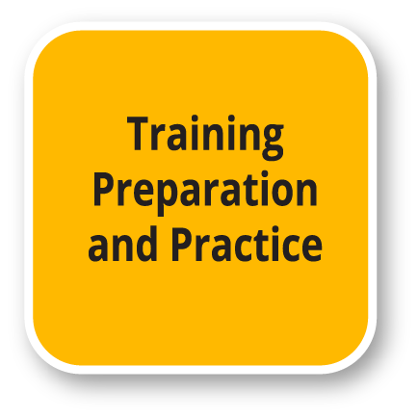
Section 5 – How to Investigate
Training, Preparation & Practice
38
20
BC Forest Safety
Notes:
Show your participants the slide and let them know that the following information will be on the training, preparation and practice that should occur before an incident investigation takes place.

Slide 33
Section 5 – How to Investigate
Training, Preparation & Practice
1 ) Training for both Employer and Worker representatives.
2) Preparation:
Necessary equipment
Investigation team
Documentation – refer to the EIIR form 52E40 (form shouldn’t drive the investigation)
39
21
BC Forest Safety
Notes:
Explain the key points around training, which should include employer and worker representatives.
Explain the importance of being prepared on all levels. This includes preparing workers and materials.
PARTICIPANT MANUAL: Answer questions about training.
Explore what equipment is needed for an investigation.
PARTICIPANT MANUAL: Includes a list of equipment. Should anything be added?
Review the characteristics of a good investigation team - collaboration is very important.
Emphasize the practical limits a small company may face.
PARTICIPANT MANUAL: Write down points to remember about their investigation team.
Reinforce the types of documentation that support incident investigations.
ACTIVITY: Discussion on why the investigation form shouldn’t be used to drive the investigation.
Next slide deals with Emergency Response Planning.

Slide 34
Section 5 – How to Investigate
Training, Preparation & Practice
Preparation includes emergency response planning:
First aid preparation
Emergency Drills
All types
Emergency Response Plans
All emergencies
Emergency Response Planning Resources – BCFSC
43
22
BC Forest Safety
Notes:
Give an overview of the importance of emergency response planning, including first aid preparation and emergency drills.
Point out OHS Reg. 4.13 requires ERPs https://www.worksafebc.com/en/law-policy/occupational-health-safety/searchable-ohs-regulation/ohs-regulation/part-04-general-conditions#SectionNumber:4.13
Draw their attention to the BCFSC website - tool for creating an ERP.
PARTICIPANT MANUAL: Answer the question about being more prepared in this area.

Slide 35
Section 5 – How to Investigate
Training, Preparation & Practice
3) Practice
Why does this course contain practice?
Why is it important to practice, share knowledge and continuously learn?
How can I gain practice so I can improve my skills?
43
22
BC Forest Safety
Notes:
Discuss the importance of practicing incident investigations with the two questions posed here.
ACTIVITY: Brainstorm ways they can improve their investigation skills.

Slide 36
Section 5 – How to Investigate
Incident Occurs
44
BC Forest Safety
Notes:
Explain what you should do now, including to:
Ensure the safety of the responders
Provide first aid and transport
Make notifications as needed - WorkSafeBC, etc.
Secure the scene
Begin the Investigation
Discuss how people typically want to assist in an emergency without thinking of their own personal safety
This can lead to more victims

Slide 37
Section 5 – How to Investigate
Gathering Information – The Five P’s
44
23
BC Forest Safety
Notes:
Introduce the five P’s.
Explain that they don’t need to use this exact method, as long as they gather this information.

Slide 38
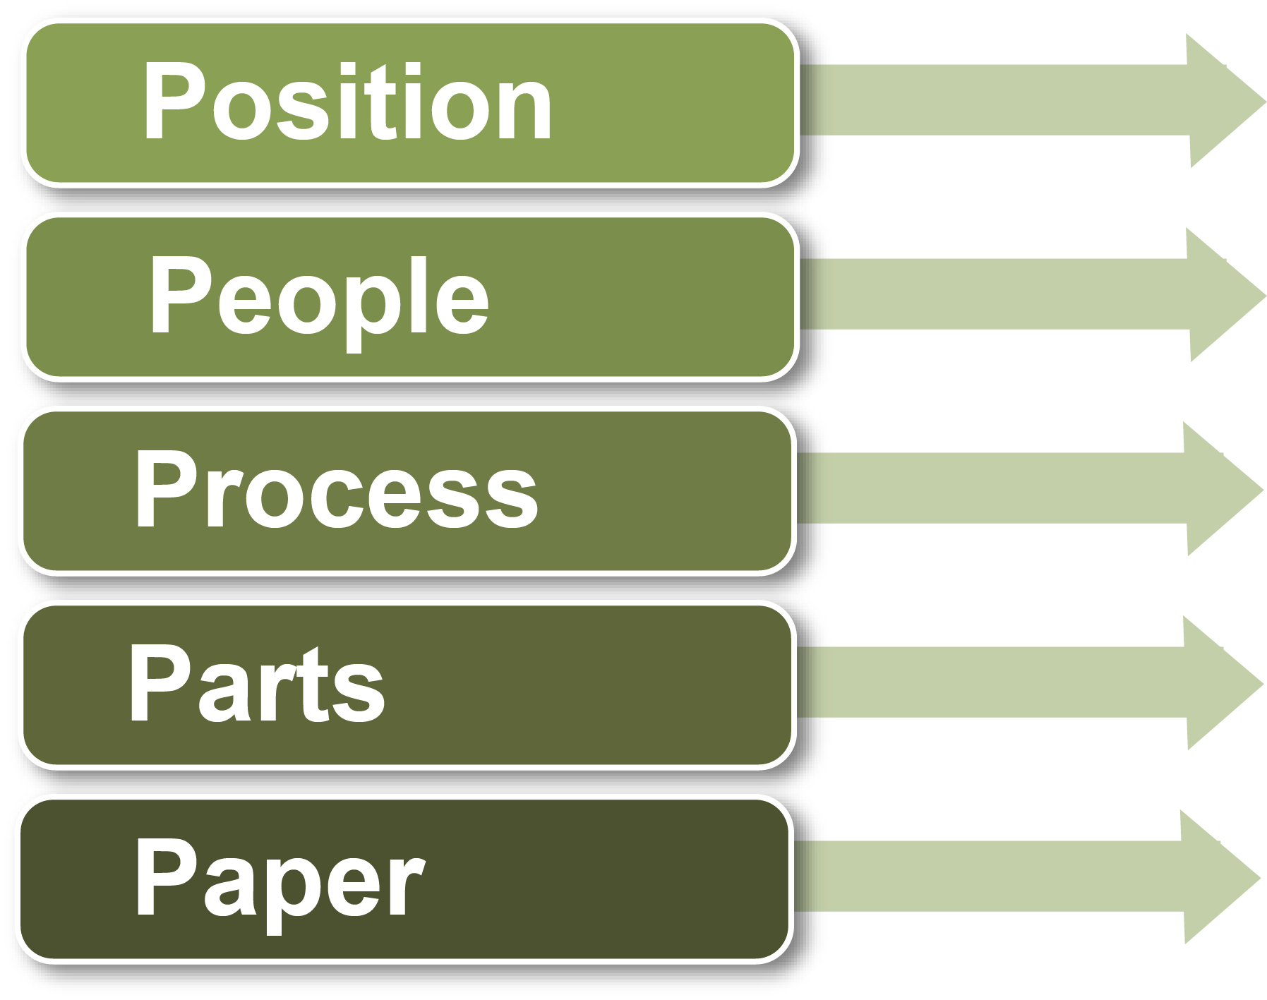
Section 5 – How to Investigate
Gathering Information – The Five P’s
45
23
BC Forest Safety
Notes:
Explain this stage is about data collection. They should:
Look for information from a combination of interviews and reviews of the scene, documents and records, and analysis.
Stay curious and open-minded.
PARTICIPANT MANUAL: For each of the five P’s, there are sample questions that can be used to collect information during an investigation.

Slide 39
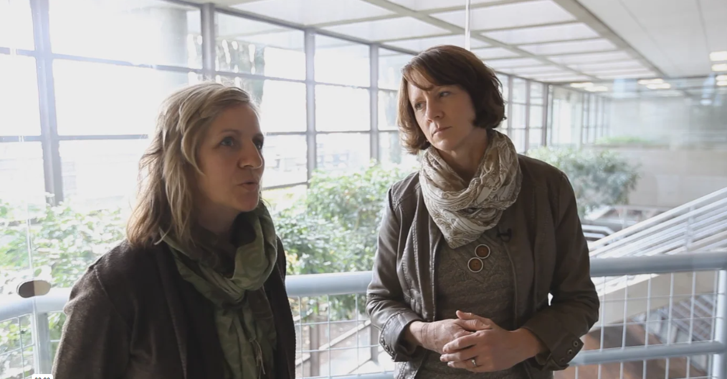
Section 5 – How to Investigate
Gathering Information – The Five P’s
Be open-minded in your investigation.
Video – Objective Analysis
46
BC Forest Safety
Notes:
Show video (Time - 2:26) which features a WorkSafeBC specialist and Board Officer.
Discuss the key ideas.

Slide 40
Section 5 – How to Investigate
Gathering Information – The Five P’s
1. Position
At the time of the incident
Of the worker and equipment
Physical environment
Data collection
46
24
BC Forest Safety
Notes:
Discuss the first “P” – position.
What does position mean?
What are some potential problems regarding position?
Things may have been moved
Weather impacts
Animal activity/disturbance
Scene disruption by first responders
Any others?
Explain that the speed at addressing/confirming positions and gathering evidence (photographs, diagrams, measurements) is critical.
Discuss the use of:
Photographs
Sketches/Diagrams
Measurements
Emphasize that the Participant Manual has extremely helpful questions for all the five P’s.
PARTICIPANT MANUAL: Answer the question about collecting eyewitness statements.

Slide 41
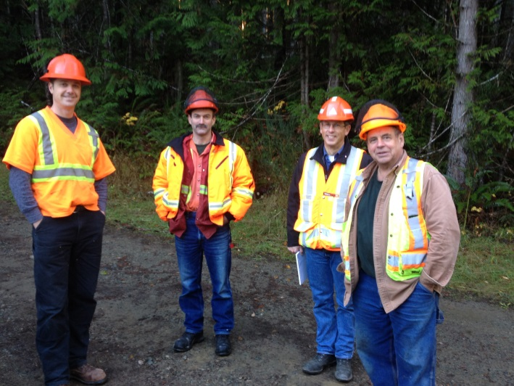
Section 5 – How to Investigate
Gathering Information – The Five P’s
2. People
Interview the injured worker
Interview others including:
Witnesses
Others with information
Supervisor or Manager
First aid attendant
Technical specialists
47
25
BC Forest Safety
Notes:
Discuss the second “P” – people.
Explain who you might interview and that interviewing the injured worker is essential.
Explain that the injured worker may not remember the incident because the brain will defend itself against traumatic events. You should assess the physical and mental state of the individuals involved, both before and after the incident.
Explain that you should only interview witnesses that actually saw something.
Discuss/explain “other persons with information”.
Discuss why there are differences in information received.
Explain why memories are fallible OR how they change over time once discussions begin.
Explain that if you use “technical specialists” it may impact your 30-day investigation window.

Slide 42
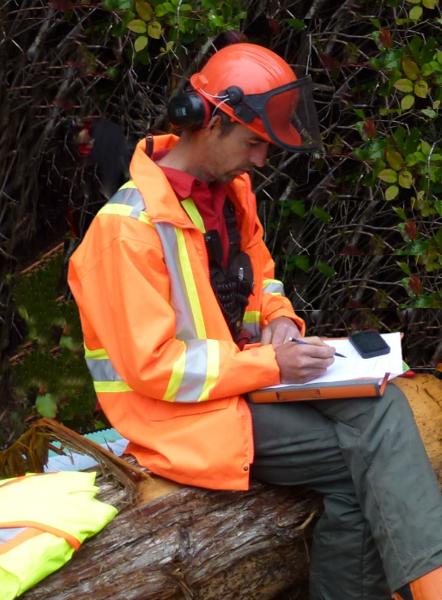
Section 5 – How to Investigate
Gathering Information – The Five P’s
2. People
Witness information
Interviewing skills
48
25
BC Forest Safety
Notes:
People (continued)
Discuss these pointers around witness information:
Separate witnesses as soon as possible, then provide paper and pen to each one and ask them to write out what they actually saw and/or remember – not what they have been told.
Prevent witnesses from having discussions together.
Discuss these pointers about interviewing skills:
The first telling of the story is usually the most accurate.
The more the story is told – the more changes likely occur. This may be good or bad, but it’s usually not intentional. They may enhance some information and downplay others. They may form biases/opinions. To avoid this, have them go through the story once – without writing, then have them do it a second time – while you take notes.
A few people may lie or try to deceive – but they are generally trying to protect someone (e.g., self or other).
PARTICIPANT MANUAL: Give the learners time to write key points about collecting eyewitness statements.

Slide 43
Section 5 – How to Investigate
Gathering Information – The Five P’s
Interviewing Skills
Video presentation by
Carla MacLean, Ph.D.
Kwantlen Polytechnic University
Video – Interviewing Skills
49
26
BC Forest Safety
Notes:
Play the video that shows Carla MacLean’s presentation on good interviewing. (Time 9:34)
After viewing, ask for comments, reactions, or questions and discuss topics raised.
Point out that the Participant Manual has an outline of the skills presented.
Discuss the different types of interview questions:
Open ended questions
Closed questions
Review examples in the Participant Manual of open and closed-ended questions.
Discuss tips for interview questions.
Discuss confidentiality.
PARTICIPANT MANUAL: Write key points they want to remember about conducting interviews.

Slide 44
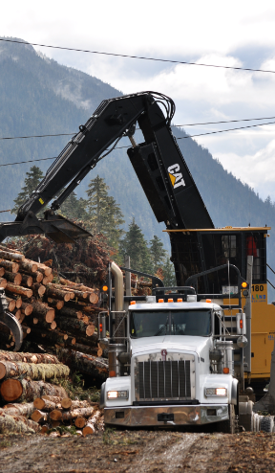
Section 5 – How to Investigate
Gathering Information – The Five P’s
3. Process
Determine the work processes or procedures that were being followed at the time of the incident.
Upset conditions vs normal operations?
Did safe work procedures (SWP) exist?
Unsafe acts or unsafe conditions?
50
31
BC Forest Safety
Notes:
Discuss the third “P” – process.
Explain what process means.
Explore the idea of upset conditions.
Were the conditions upset or normal?
Discuss if safe work procedures (SWP) had been established or were being followed?
Discuss unsafe acts vs. unsafe conditions.
Review the sample questions from the manual they can ask about the process.

Slide 45
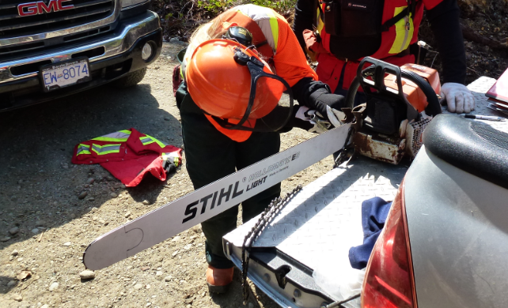
Section 5 – How to Investigate
Gathering Information – The Five P’s
4. Parts
Identify any equipment and
materials being used by the
workers at the time of the
incident:
PPE?
OEM vs. aftermarket parts?
Chemicals?
For every unsafe condition or act, determine why the situation was allowed to exist.
52
32
BC Forest Safety
Notes:
Discuss the fourth “P” – parts.
Explain what is meant by parts.
Discuss the condition of the equipment and materials. Were they original equipment manufactured (OEM) or “jobber” parts?
Evaluate the PPE being used.
Discuss if any chemicals were involved as well as storage and handling methods. Was their proper training? Were the Safety Data Sheets (SDS) requirements followed?
Review the sample questions in the manual they can ask about the parts.
Explain how it’s necessary to determine why unsafe situations were allowed to exist.

Slide 46
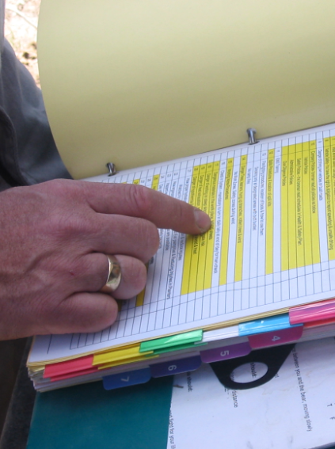
Section 5 – How to Investigate
Gathering Information – The Five P’s
5. Paper
Gather the relevant safety documents and records for the workplace:
Site-specific plans
Personnel records
Training records
Other relevant paperwork
53
33
BC Forest Safety
Notes:
Discuss the fifth “P” – paper.
Explain what is meant by paper.
List the types of documents that could be gathered for the investigation. Review the list in the manual and ask participants for other examples.

Slide 47
Section 5 – How to Investigate
Analysis
54
34
BC Forest Safety
Notes:
Talk to your participants about the importance of laying out the sequence of events for the incident.
Explain that the purpose of a timeline is to identify any gaps in the information and follow up to get the missing details.
Demonstrate an activity where the key events in the incident are written out on sticky notes and stuck to a surface – a good approach to determining if anything has been missed.
Explain how critical thinking is essential to the analysis process.
Discuss how investigators need to think critically about the source of their information, any biases that may exist in themselves or others, and the politics and agendas that might be present in an organization.

Slide 48
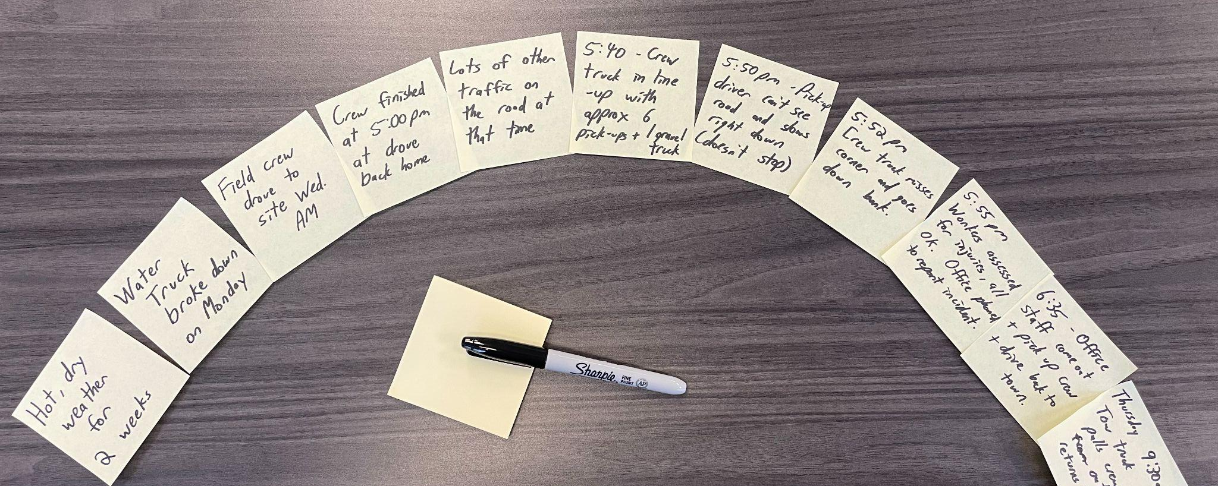
Section 5 – How to Investigate
Analysis
Sequence of events
Lay out the timeline for the incident, identify any gaps, follow up to get missing details
Critical Thinking
About sources of information, bias, and ‘politics and agendas’
54
BC Forest Safety
Notes:
Talk to your participants about the importance of laying out the sequence of events for the incident.
Explain that the purpose of a timeline is to identify any gaps in the information and follow up to get the missing details.
Demonstrate an activity where the key events in the incident are written out on sticky notes and stuck to a surface – a good approach to determining if anything has been missed.
Explain how critical thinking is essential to the analysis process.
Discuss how investigators need to think critically about the source of their information, any biases that may exist in themselves or others, and the politics and agendas that might be present in an organization.

Slide 49
Section 5 – How to Investigate
Bias
Importance of being open-minded and thinking “outside the box.”
Jumping to conclusions can lead to a false outcome.
Example: Vehicle loses control and goes off the road. Is speed always the cause?
55
BC Forest Safety
Notes:
Review an example that demonstrates how easy it is to give in to biases.
There is an incident where the driver loses control of their vehicle and goes off the road.lt.
Upon investigation, you learn that the person has a history of speeding. So your immediate assumption is that the driver was speeding and this caused the incident.
But upon deeper investigation, you learn there was a mechanical problem with the vehicle, and this was the cause of the accident.
If you had settled for a quick and easy investigation, and had followed your biases, you would have come to the wrong conclusions. Therefore, keeping an open mind and thinking outside the box are essential to finding the truth.

Slide 50
Section 5 – How to Investigate
Analysis
Establish what are known facts
Review the direct and indirect evidence
Consider and evaluate other data (statements or opinions)
Evaluate and “weigh” the data - each data piece in not the same weight
Some pieces may not fit – or be missing
Use critical thinking and stay objective
Make conclusions and answer “what happened?”
55
BC Forest Safety
Notes:
Discuss the process they should take once all the information is gathered:
Analyze the known facts.
Review the evidence.
Consider / evaluate any other date related to the incident.
Evaluate and “weigh” the data.
Acknowledge some pieces of data may be missing or may not fit.
Consider that some pieces may be missing or not “fit.“
Use critical thinking and stay objective.
Derive conclusions at the end.

Slide 51
Section 5 – How to Investigate
Identify Unsafe Conditions, Acts, or Procedures
56
35
BC Forest Safety
Notes:
Explain that in this unit you will help your participants understand how to determine unsafe conditions, acts, or procedures. You will also discuss the type of thinking and questions that will help them to determine causes.

Slide 52
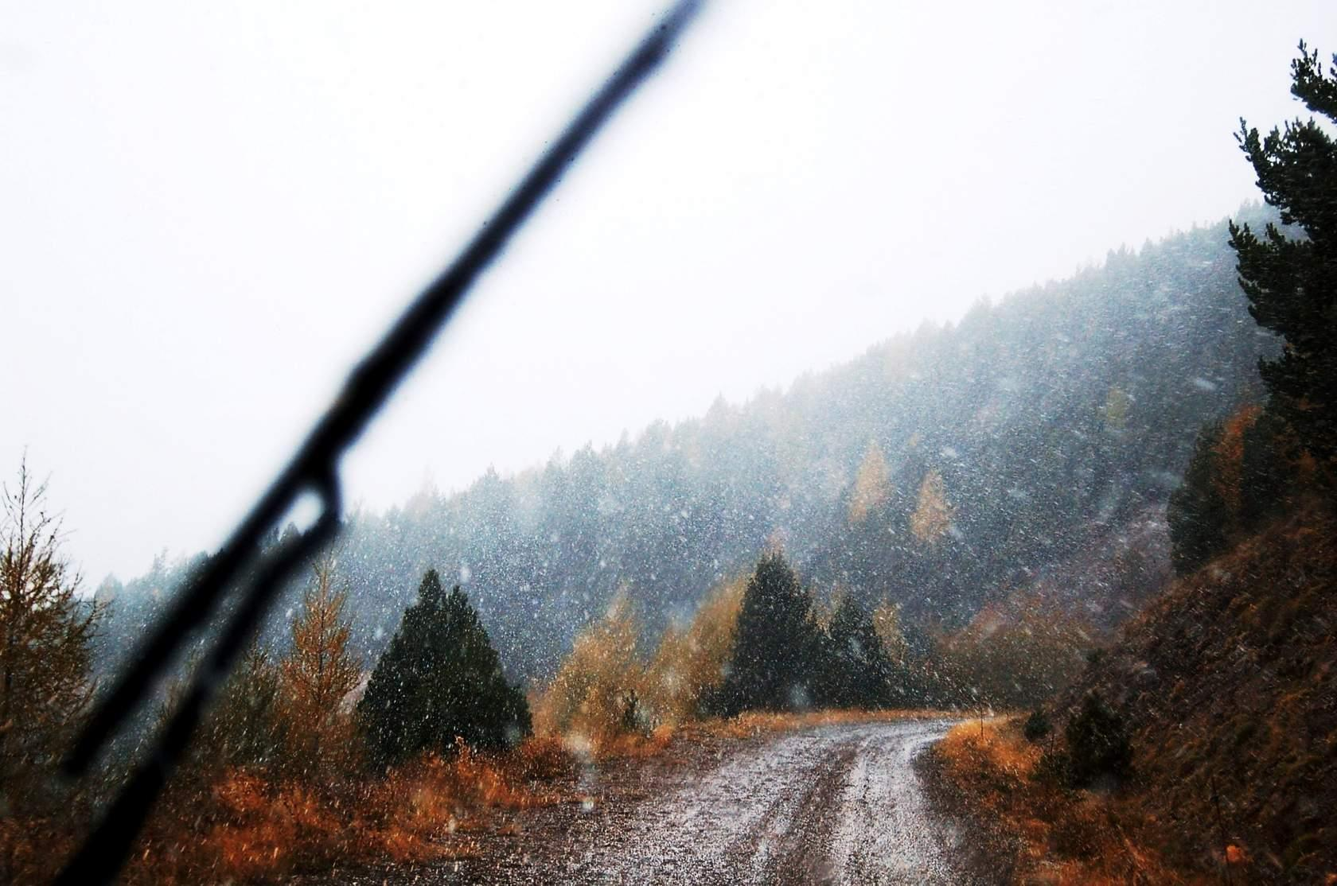
Section 5 – How to Investigate
Identify Unsafe Conditions, Acts, or Procedures
Describe anything that contributed to the incident:
Why did this incident happen?
What was the sequence of events?
Why did each event happen?
Avoid stopping at personal factors.
Look for conditions, acts and
procedures that are more immediate
and can be corrected quickly.
56
BC Forest Safety
Notes:
Discuss how in order to identify unsafe conditions, acts, or procedures that significantly contributed to the incident, you have to ask yourself questions. Why did this incident happen? What was the sequence of events? Why did each event happen? Avoid stopping at personal factors such as “the worker was careless.” These are the ones that can be addressed quickly and with more immediate effect.

Slide 53
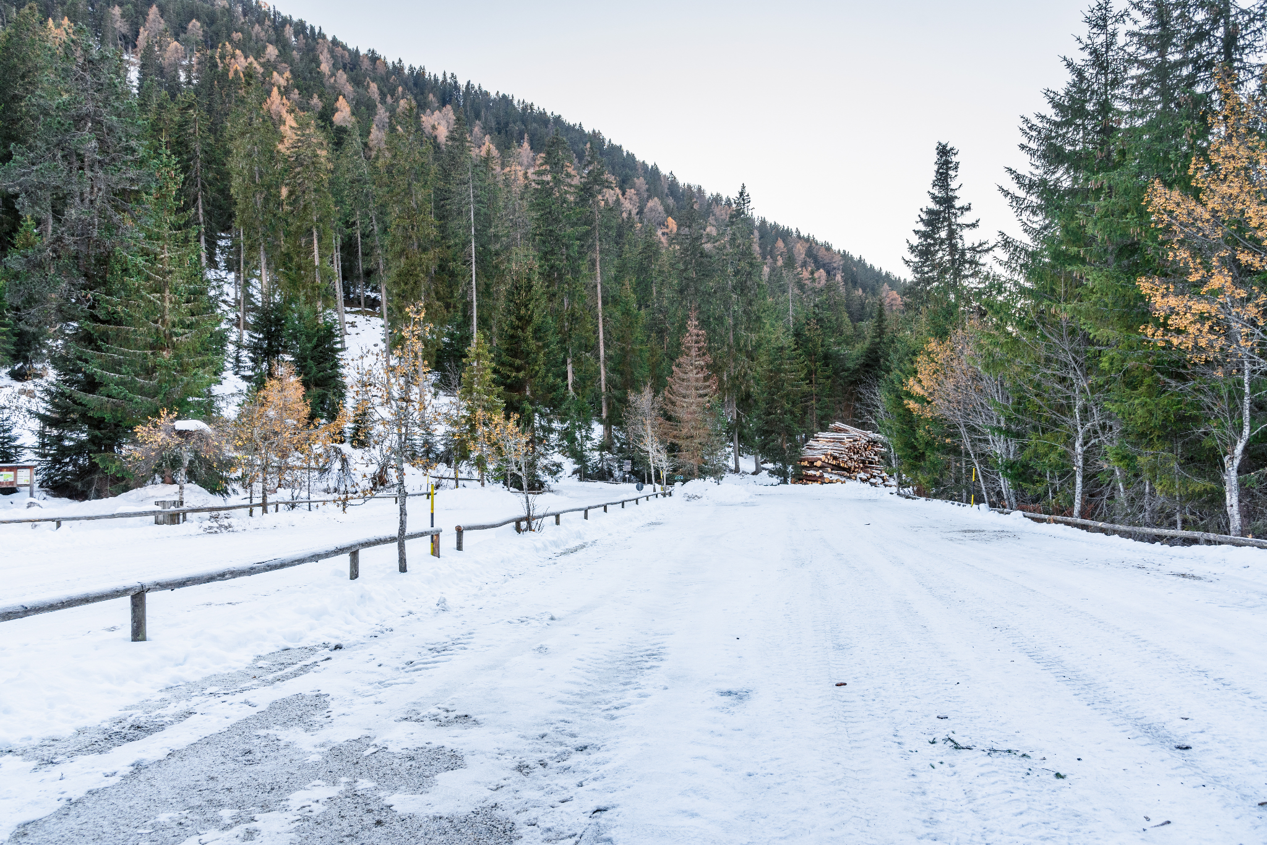
Section 5 – How to Investigate
Identify Unsafe Conditions, Acts, or Procedures
Scenario:
Worker falls while crossing an icy parking lot
What conditions, acts, or procedures contributed to the incident?
Was the parking lot sanded and salted properly?
Was the salt used ineffective?
Did clogged gutters lead to a backup of water and ice?
56
BC Forest Safety
Notes:
Explain that you will look at an example.
Imagine a situation where icy conditions make walking in the parking lot dangerous. As a result, a worker falls down while crossing between buildings. Is it the worker’s fault for walking in an unsafe area? Perhaps, but other factors may play a part. Perhaps the parking lot was not salted properly, or the type of salt was ineffective. Maybe some debris was littering the parking lot and making it difficult to walk. Maybe there was a clogged gutter that was causing an unusual amount of water to spill on the parking lot.
These are the kinds of unsafe conditions, acts or procedures that could contribute to the incident.

Slide 54
Section 5 – How to Investigate
Preliminary Corrective Actions
56
36
BC Forest Safety
Notes:
Explain that in this section your participants will learn about the importance of putting effective preliminary corrective actions in place.
Let your participants know that the regulations use the terminology “Preliminary Corrective Actions”, which are essentially recommendations.
You want to emphasize to your participants the importance of putting effective preliminary corrective actions in place as part of an investigation. Reference WCA s. 71(3): ”Following the preliminary investigation, the employer must, without undue delay, undertake any corrective action determined to be necessary under subsection 71(1)(b).”

Slide 55
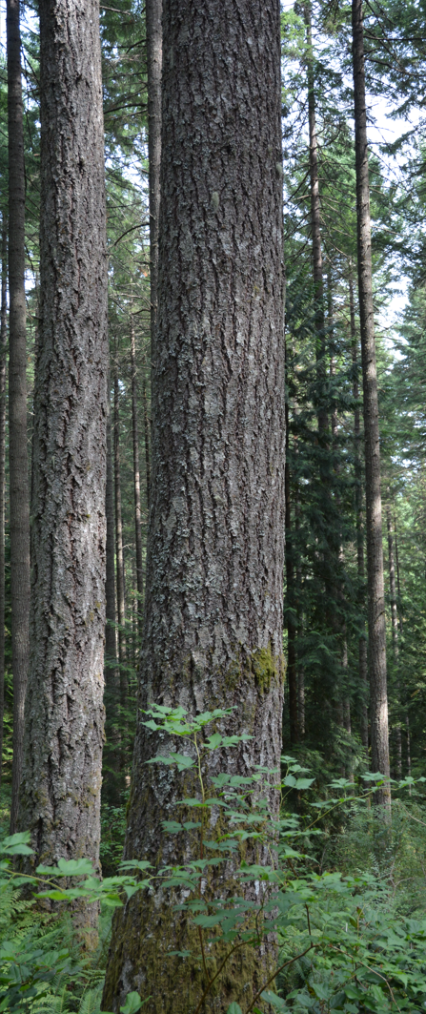
Section 5 – How to Investigate
Preliminary Corrective Actions
To develop effective corrective actions, accurately identify the unsafe conditions, acts and procedures
Each corrective action must link back directly to an unsafe condition, act or procedure
57
BC Forest Safety
Notes:
Explain that your participants should understand by this point that identifying the unsafe conditions, acts, and procedures will be essential to developing effective preliminary corrective actions.
Let your participants know that if they have done a good job of finding the unsafe conditions, acts, and procedures, they should be able to write good recommendations.
The recommendation needs to be linked directly to the unsafe conditions, acts, and procedures.

Slide 56
Section 5 – How to Investigate
SMART Corrective Actions
Corrective actions must be SMART:
Specific
Measurable
Achievable
Realistic
Timely
57
36
BC Forest Safety
Notes:
Talk to your participants about the importance of developing corrective actions that are SMART.
SMART means:
Specific – giving an idea of actions to be taken to achieve the intended outcome(s);
Measurable – able to be followed up on to confirm that the actions have been done;
Achievable – recommended actions must be able to be carried out;
Realistic – cost effective, as well as practical (taking into account legal and other constraints)
Timely – you want recommendations to be completed as soon as possible to prevent recurrence – but they should have a reasonable timeframe.
PARTICIPANT MANUAL: Give your participants a couple of minutes to write down the key characteristics of effective corrective actions (i.e., SMART).

Slide 57
Section 5 – How to Investigate
SMART Corrective Actions
A worker who drives a pickup did not have emergency equipment for a wildfire. What corrective actions are needed?
Specific
Susan S.is to inspect all 8 of the worker’s pickups to make sure they have all the required emergency equipment (backpack pump, shovel, spill kit and fire extinguisher).
Non-specific
We need to improve how we respond to emergencies.
57
BC Forest Safety
Notes:
Discuss examples of SMART recommendations. Compare them to NON-SMART examples.
Let’s say a significant fire started at the worksite and one of the contributing factors was that the appropriate fire fighting equipment wasn’t on site. What are effective corrective actions to prevent this from happening in the future?
Review each example:
Specific
Susan S. the supervisor is to inspect all 8 of the worker’s pickups to make sure they have all the required emergency equipment (backpack pump, shovel, spill kit and fire extinguisher).
Non-specific
We need to improve how we respond to emergencies.

Slide 58
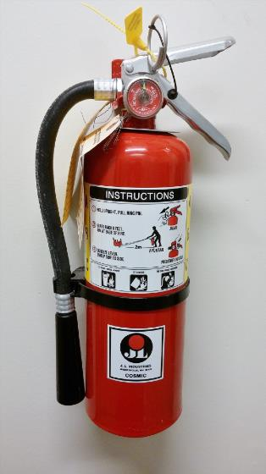
Section 5 – How to Investigate
SMART Corrective Actions
Measurable
Document the inspections on the monthly pickup inspection report and submit to Gary G., the shop manager who will replace any missing items.
Non-measurable
Make sure emergency equipment is on site.
57
BC Forest Safety
Notes:
Review this example:
Measurable
Document the inspections on the monthly pickup inspection report and submit to Gary G., the shop manager who will replace any missing items.
Non-measurable
Make sure everyone has their emergency equipment.

Slide 59
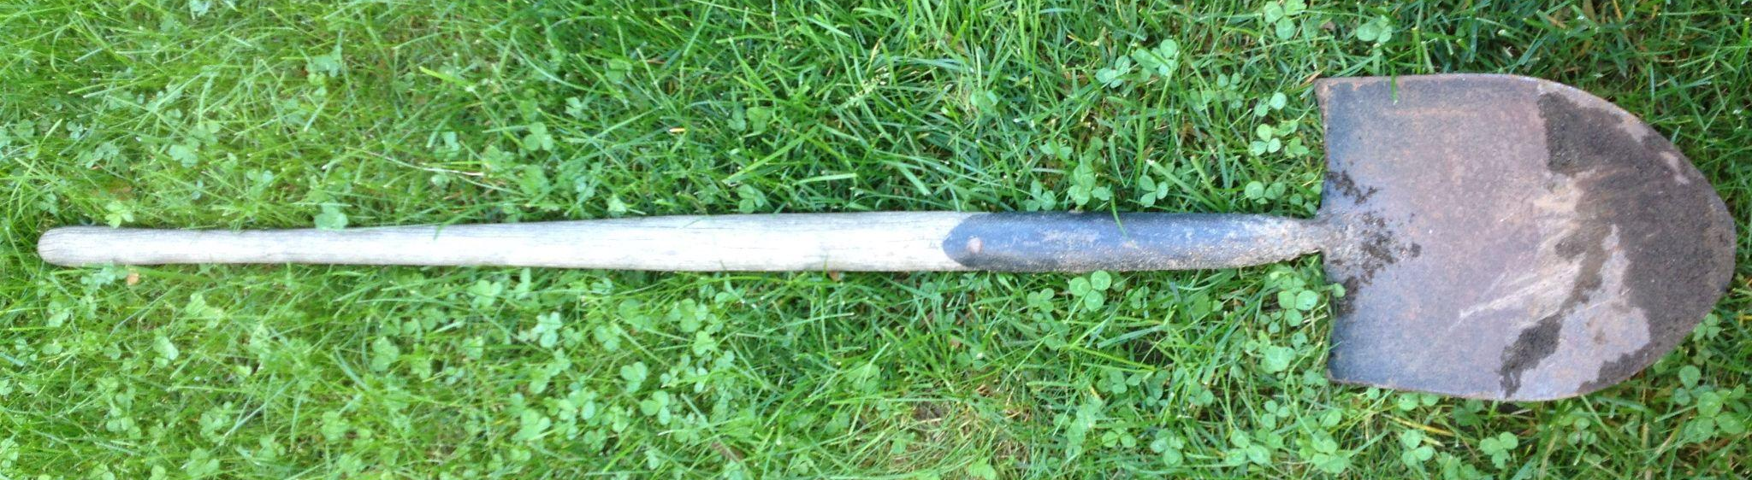
Section 5 – How to Investigate
SMART Corrective Actions
Achievable
All the workers have been instructed to bring their pickups to the office to be inspected tomorrow (September 15).
Not Achievable
The workers and their pickups are at various field sites and camps but should be back at some point this week.
58
BC Forest Safety
Notes:
Review this example:
Achievable
All the workers have been instructed to bring their pickups to the office to be inspected tomorrow (Wednesday, September 15).
Not Achievable
The workers and their pickups are at various field sites and camps but should be back at some point this week.

Slide 60
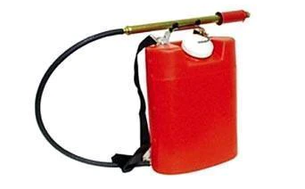
Section 5 – How to Investigate
SMART Corrective Actions
Realistic
Susan must submit the reports to Gary no later than Friday, Sept. 17 and he will replace any missing equipment.
Not Realistic
Workers to purchase anything that is missing and we’ll reimburse you later.
58
BC Forest Safety
Notes:
Review this example:
Realistic
Susan must submit the reports to Gary no later than Friday, Sept. 17 and he will replace any missing equipment..
Not Realistic
Purchase anything that is missing and we’ll reimburse you later.

Slide 61
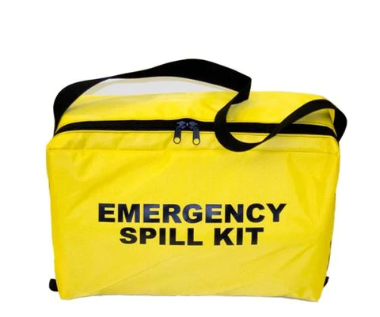
Section 5 – How to Investigate
SMART Corrective Actions
Timely
Any replacement equipment will be purchased by Gary on Monday, Sept. 20 and placed on the pickups on Tuesday, Sept. 21.
Not Timely
This should be done in the next couple of months.
58
BC Forest Safety
Notes:
Review this example:
Timely
Any replacement equipment will be purchased by Gary on Monday, Sept. 20 and placed on the pickups on Tuesday, Sept. 21.
Not Timely
This should be done in the next couple of months.

Slide 62
Section 5 – How to Investigate
Recommendation Tips
Don’t use these corrective actions:
Work safely
Don’t take chances
Watch out
Be more careful
Drive defensively
Pay more attention
Avoid hazards
58
BC Forest Safety
Notes:
Now that participants know more about effective corrective actions, let them know that they are no longer allowed to use the following recommendations as they are essentially meaningless.
Work Safely
Don’t take chances
Watch out!
Be more careful.
Drive defensively.
Pay more attention.
Avoid hazards.
None of these meet the SMART criteria.

Slide 63
Section 5 – How to Investigate
Corrective Action Tips
Corrective actions should be:
Developed initially as part of the preliminary investigation
Reviewed and updated as part of the full investigation
Linked directly to an unsafe condition, act or procedure
58
BC Forest Safety
Notes:
Discuss some key components regarding corrective action recommendations.
Recommendations should be:
Developed in the preliminary investigation.
Reviewed/revised/updated as necessary after all information has been collected and all causes identified in the full final report.
Linked directly to the unsafe conditions, acts and procedures that contributed to the incident.

Slide 64
Section 5 – How to Investigate
Identify Causes of the Incident
58
37
BC Forest Safety
Notes:
Explain how in this section, your participants will learn about the importance of identifying the causes of an incident.

Slide 65
Section 5 – How to Investigate
Identify Causes of the Incident
What are the deeper, underlying causes of the incident?
These generally require corrections that take a longer time to implement.
Cause definitions handout:
Cause |  | Definition | Example
1. | Grip or Hold | Failure to secure an object, manually or with the use of a mechanical device(s), such that the object is inadvertently released. | Drums on a pallet are lifted and fall off because they were not restrained/ secured prior to lift.
58
37
BC Forest Safety
Notes:
Explain that the next investigation step is to think beyond the immediate actions that need to be taken to the deeper, underlying causes of the incident.
These are generally causes that will require corrections that take a longer time to implement.
Explain how to use the document that gives the cause of definitions.
Give an example: Grip or hold.
PARTICIPANT MANUAL: Point out the activity where they have to identify the cause in specific examples.

Slide 66
Section 5 – How to Investigate
Asking Questions
Investigating an incident involves asking questions.
5W’s + 1H:
Who
What Usually easier
Where
When Sometimes tougher
Why
How
Take the most time
59
38
BC Forest Safety
Notes:
Discuss how asking questions is a key part of an incident investigation. Some questions are easier to answer than others but usually answering the harder questions reveal the most useful information.
Who/what/where - are usually easy to identify
When - may or may not be easy, depending on the last check in and whether the incident was observed or not.
Why & How - These questions get to the guts of the investigation. They also take the most time to determine (depending on the investigator’s skills).

Slide 67
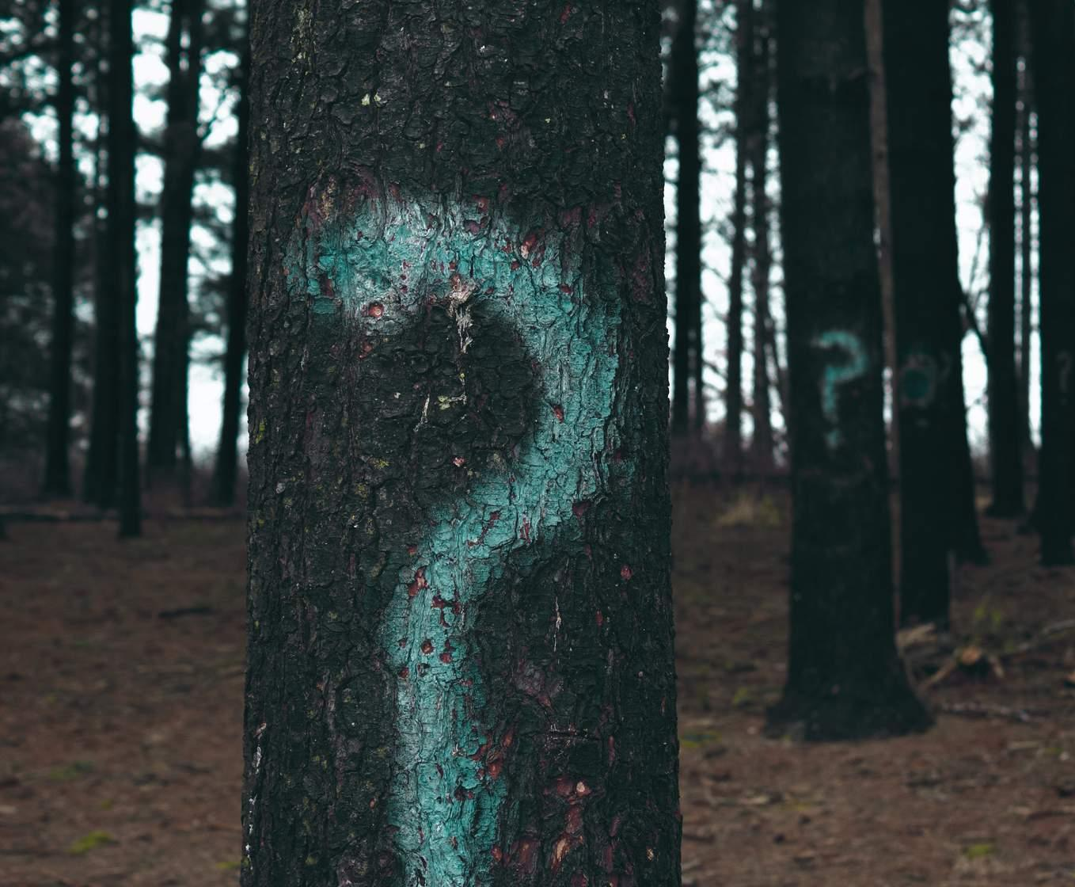
Section 5 – How to Investigate
Identify Causes of the Incident – 5 Why’s?
One approach to digging into the causes is the “Five Why’s.”
Ask “Why?” after the answer comes up.
Do this 4 or 5 times.
Process helps you determine what happened.
59
BC Forest Safety
Notes:
Explain to the participants that one approach to digging into causes is the ‘Five Why’s’, which involves asking “Why?” several times (usually 4 or 5 times) each time an answer or reason comes up for what happened.
Explain that:
The Five Why’s is a system of continuing to ask objective, open-ended questions until the answer is simple and clear.

Slide 68
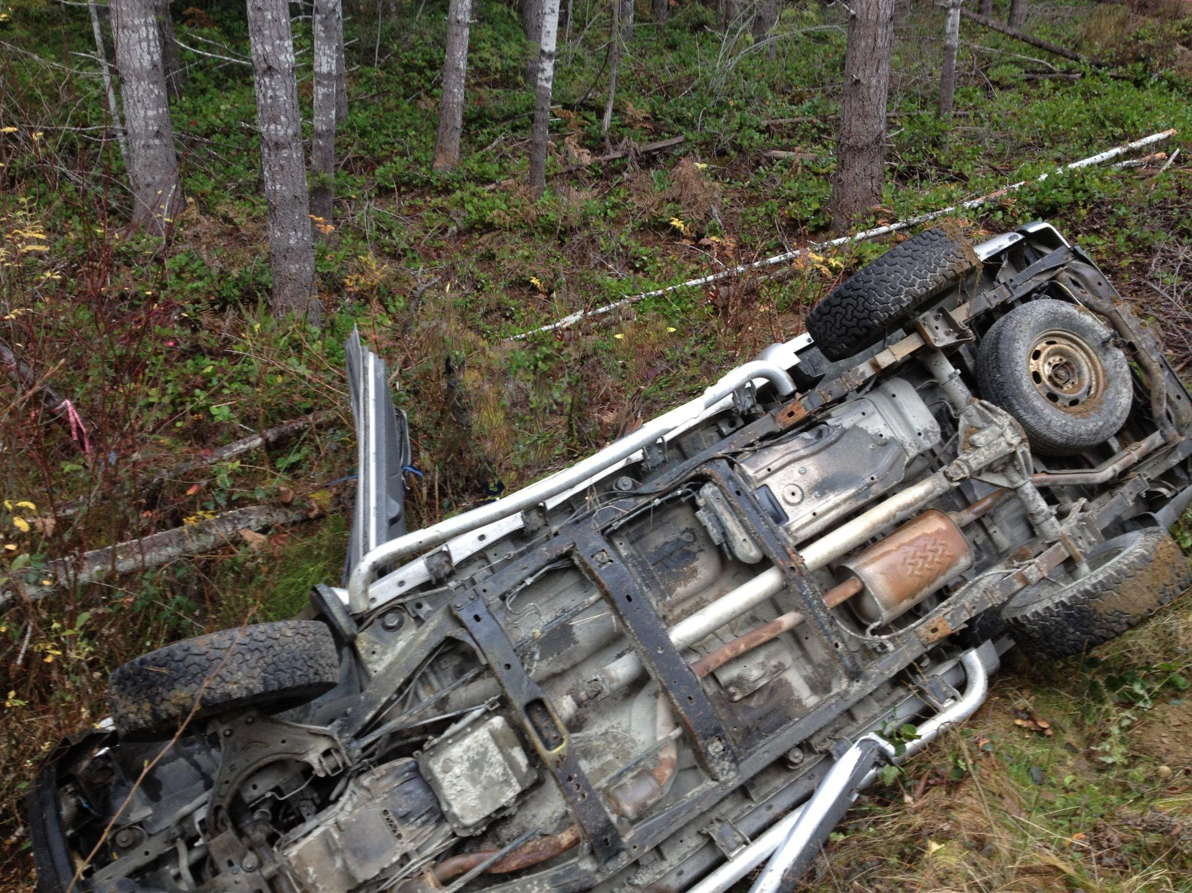
Section 5 – How to Investigate
Identify Causes of the Incident
Why were they driving fast?
Because they were late…
Why?
Because they had to change two flat tires…
Why?
Because the tires burst on the road…
Why?
Because the tires were bought as used tires…
Why?
Because the tires were cheaper but not the type needed for the gravel roads.
Unsafe conditions, acts, or procedures? Causes?
Identifying Causes Analysis – Truck goes off the road and rolls.
Context:
Crew was travelling on a logging road from one site to another.
Ask the 5 Why’s
60
BC Forest Safety
Notes:
Explain that you will look at an example.
Review the use of Why questions.
Review the unsafe conditions, acts, or procedures?
Review the causes?

Slide 69
Section 5 – How to Investigate
Identify Causes of the Incident – Human Factors
Equipment, controls, panels, pipes, machinery, tools, etc.
Facilities
Procedures, risk assessments, processes, investigation, training, etc.
Management
Systems
People
Human characteristics
and behaviour
60
39
BC Forest Safety
Notes:
Discuss the term “human factors.”
Discuss the many human factors that need to be considered when investigating incidents including facilities, management systems and people.
Key Points:
Workers do not intend to create incidents.
They do things that seem reasonable to them.
They do not think they will get hurt.
A key question to ask:
How is it that the action seemed reasonable, rational and safe to the worker at that time?
Review the examples in the manual that show how “common sense” is relative.

Slide 70
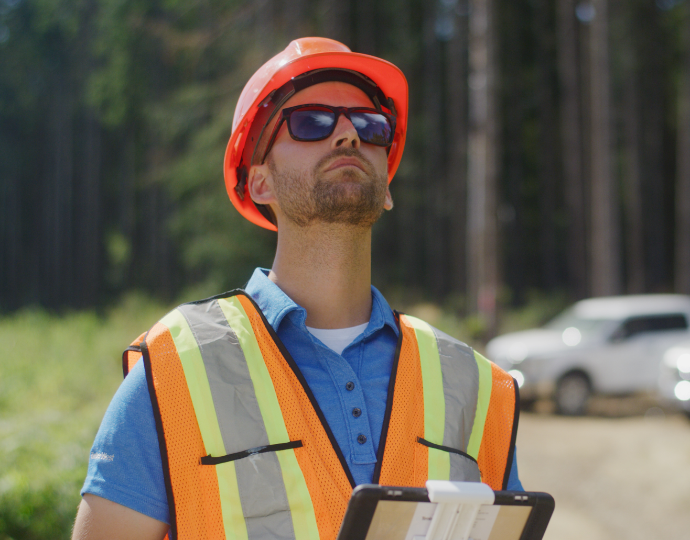
Section 5 – How to Investigate
Identify Causes of the Incident – Human Factors
What human factors might be affecting this worker?
Think about the facilities, people and management systems.
61
39
BC Forest Safety
Notes:
PARTICIPANT MANUAL: Ask your participants to brainstorm all the things that might be affecting the worker.
Then ask how those things might affect the worker’s ability to do their job, their judgement, etc.

Slide 71
Section 5 – How to Investigate
Additional Corrective Actions
61
40
BC Forest Safety
Notes:
In this section, your participants will learn about the importance of putting additional corrective actions in place.

Slide 72
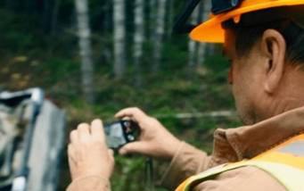
Section 5 – How to Investigate
Additional Corrective Actions
Additional corrective actions need to address the causes identified in the previous step.
Corrective actions:
Correct a condition or problem
Prevent similar incidents
Look at the deeper, underlying causes.
61
BC Forest Safety
Notes:
Discuss how additional corrective actions will address the causes identified in the previous step.
Remind them that corrective actions aim to:
Correct a condition or problem within the company
Prevent similar incidents from happening in the future
To be effective, it’s necessary that the deeper, underlying causes be accurately identified.

Slide 73
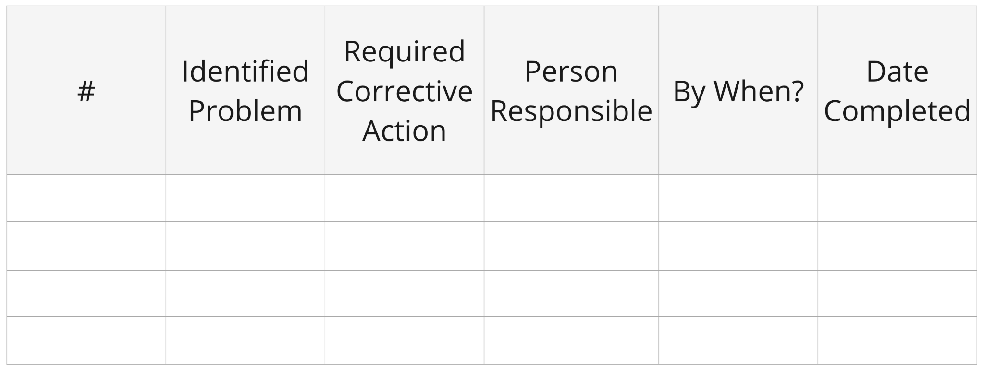
Section 5 – How to Investigate
Additional Corrective Actions - CAL
Corrective Action Logs (CAL)
Keep track of planned corrective actions and follow up
CAL can be discussed at safety meetings
61
BC Forest Safety
Notes:
Explain that corrective action logs (CAL) are created to keep track of the planned corrective actions and follow up.
They may be created as the result of the incident, but also could be due to a hazard or change in condition that’s been identified or reported.
They should also be discussed at safety meetings.

Slide 74
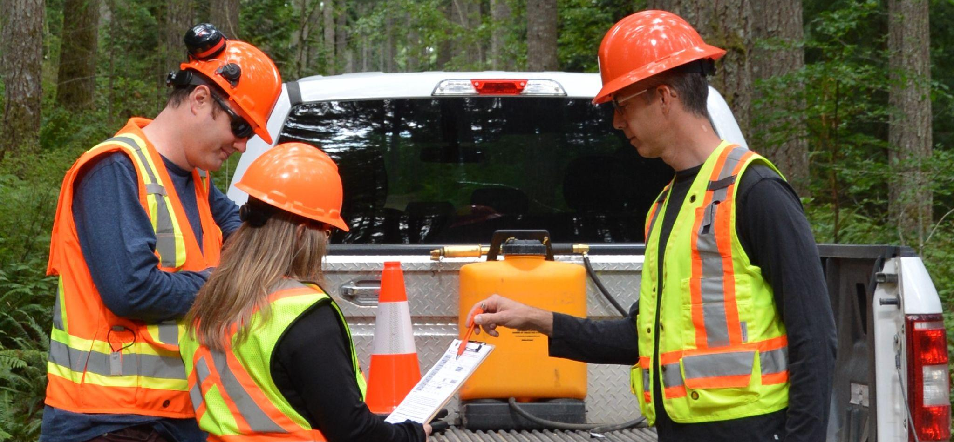
Section 5 – How to Investigate
Additional Corrective Actions – Documentation
Large Group Activity
How do the two completed Incident Investigation forms compare?
62
41
BC Forest Safety
Notes:
Explain you will do an activity to practice looking at effective incident investigations. You’ll do this by looking at two completed Incident Investigation forms.
Use the “Poor” (R-05 handout - Example A) and “Good (R-06 handout - Example B)” examples (found in the Resources section) of the completed Incident Investigation form. Review and compare the information written on each form. Have the participants list their observations in the PARTICIPANT MANUAL.
Discuss with your participants what errors and incomplete information they see on the bad example and how it differs from what is on the good investigation form.

Slide 75
Section 5 – How to Investigate
Additional Corrective Actions – Submission
When submitting the form, remember:
Follow submission instructions
People who investigated the incident are identified on report.
All blank spaces must be explained
63
BC Forest Safety
Notes:
Explain the submission process.
Explain how the form should be signed by management.
Explain how you need to explain all blank spaces.

Slide 76
Section 5 – How to Investigate
Follow Up
63
42
BC Forest Safety
Notes:
Explain the purpose of follow up.

Slide 77
Section 5 – How to Investigate
Follow Up
What are the key parts of following up?
Were corrective actions completed on time?
Are the corrective actions making a positive difference?
Are revised or updated corrective actions needed?
63
BC Forest Safety
Notes:
Discuss WCA regulation s.71 & 72.
https://www.worksafebc.com/en/law-policy/occupational-health-safety/searchable-ohs-regulation/workers-compensation-act/part-2-occupational-health-and-safety#SectionNumber:Part2Div10Sec71
Explain how:
A person should be identified who is responsible for completing the action
A deadline should be assigned to each action
Discuss the role of management and the Joint Health and Safety Committee.
Discuss corrective action logs (CAL).

Slide 78
Section 5 – How to Investigate
Follow Up
Communication is essential:
Improved communication with ALL parties - employees, management, clients, equipment manufacturers, other divisions and operations.
Shared knowledge and learning helps other operations prevent similar injuries
Submit an Industry Safety Alert through the BC Forest Safety Council.
64
BC Forest Safety
Notes:
Explain how they need to follow up and ask:
Did the corrective action work?
What were the consequences and impacts? What was learned?
Explain the benefits/importance of communication.
Communicate widely, internally and externally
Share with the industry

Slide 79
Section 5 – How to Investigate
Wrap Up
Steps of an Investigation
64
43
BC Forest Safety
Notes:
Explain that you will now wrap up the “How to Investigate” section.
Review the different stages of an investigation.
Remind them:
Investigation is a process.
The steps are there to create a system that helps you be thorough.
What each step is and a brief reminder of what happens in each step.
These steps are designed to match with what needs to be put into the WorkSafeBC form 52E40.

Slide 80
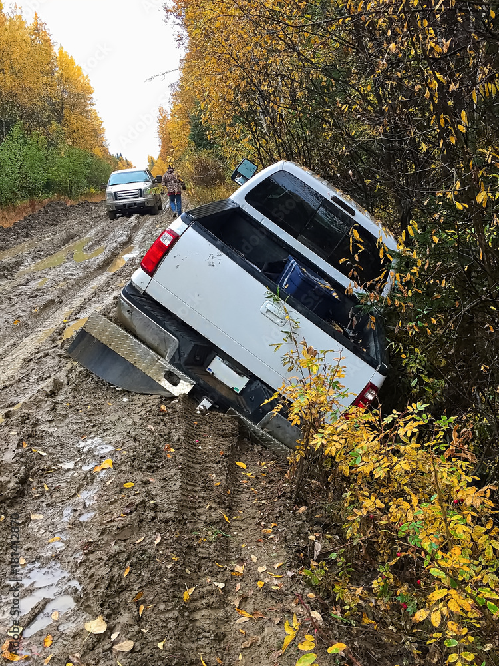
Section 6 – Investigation Practice
Practice Demonstration / Walk-through
Case Study:
Pickup Incident
View video
67
44
BC Forest Safety
Notes:
Explain that this section is designed to give your participants hands-on practice with conducting an investigation so that they will be better equipped to take on their own investigations if needed. This section is key to ensuring that your participants can apply the theory taught earlier in the course to real life examples. For this reason, ensuring enough time to practice an investigation is desirable.
Explain this section of the course is important because:
It provides your participants with hands on practice needed to help solidify their understanding of how to conduct an investigation
Practicing investigations is a key aspect of being able to do an effective investigation later.
Allows the trainer to provide feedback on completed investigations and coach participants on the use of the form, and getting to cause(s) as the basis for corrective actions.
Explain that you will conduct at least one practice investigation of a fictitious incident with your participants. If you have time, you can do a second exercise.
You will start with the Pickup Incident Investigation.

Slide 81
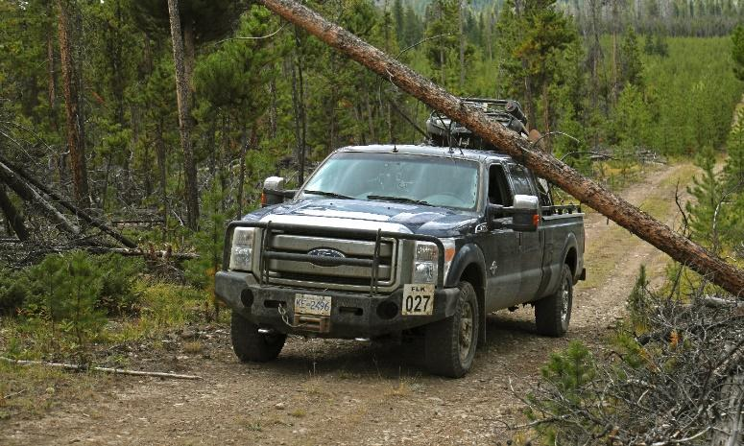
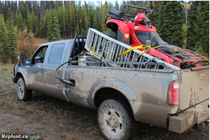
Section 6 – Investigation Practice
Additional Practice
Case Study:
Wind Event Incident
View Video
Case Study:
ATV Upset Incident
View Video
69
44
BC Forest Safety
Notes:
Explain that participants will work through a preliminary and full investigation for the second case study incident to practice using the tools that they have learned in this course.
For this incident investigation, arrange your participants into small groups (recommended group size of 3 or 4 to ensure participation). Be sure to leave sufficient time to debrief with the large group at the end.
When organizing your participants into groups, divide the experienced people into different groups so that each group has some experienced people.
Follow the Activity instructions in the trainer manual.

Slide 82
Section 6 – Investigation Practice
Wrap Up
Commitments for change?
Course Evaluation forms
71
47
BC Forest Safety
Notes:
Summarize the key learnings with your participants, as well as let them know what other resources are available to them.
Review course objectives and ask participants their key takeaways from each. Have them write these takeaways in the PARTICIPANT MANUAL.
Have your participants make a written commitment around what they are going to take on in their operations after this course in the PARTICIPANT MANUAL.
Hand out course evaluations.

Slide 83
Have a safe day!
BC Forest Safety

