Slide 1

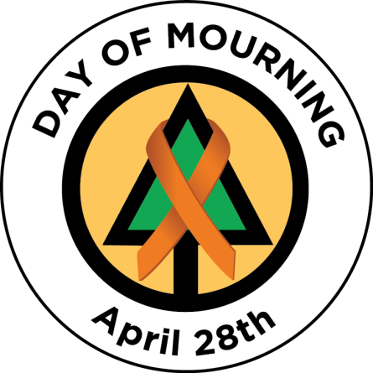

Slide 2
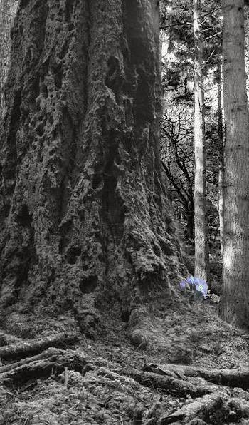
Day of Mourning – April 28
The ‘Day of Mourning’ recognizes those who have lost their lives, were injured or made ill as a result of work-related incidents or occupational diseases and focusses on renewing our commitment to preventing further workplace tragedies.
HISTORY:
The Canadian Labour Congress initiated a National Day of Mourning ceremony on April 28, 1984, and ceremonies have been held across the country ever since. This day is now recognized around the world in more than 100 countries.
April 28th was chosen as it was this date, in 1914, the first Workers’ Compensation Act was brought into effect in Canada.

Slide 3
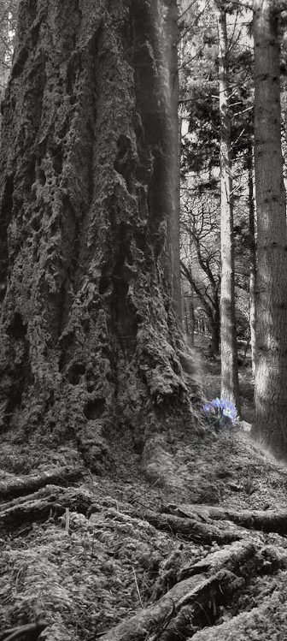
NATIONAL STATISTICS:
According to the Association of Workers’ Compensation Boards of Canada:
Every year, approximately 1,000 workers die in Canada.
Every day, nearly three workers die.
Every year, workers suffer from 250,000 work-related injuries/diseases.
Every day, workers suffer from approximately 700 work-related injuries/diseases.
A compensable injury occurs every seven seconds of each working day.
BC STATISTICS:
In 2023, there were 175 workers in BC who lost their lives to workplace injury or disease. There were 82 fatalities due to traumatic injury and 93 fatalities due to occupational disease.
BC FORESTRY INDUSTRY STATISTICS:
In 2023, there were ten work-related deaths in forestry.

Slide 4
Forestry Operations
December 8, 2023: On December 8th, a forestry worker was fatally injured at a dryland sort yard near Gold River, BC.
Fatality Alert – December 8, 2023
October 24, 2023: On October 24th, a forestry worker was fatally injured while operating an All-Terrain Vehicle (ATV) in an area northeast of Prince George.
Fatality Alert – October 24, 2023
October 23, 2023: On October 23rd, a tugboat used in log salvage operations capsized during rough conditions near Vancouver. The boat operator was found in the water and was not able to be resuscitated.
Fatality Alert – October 23, 2023
September 29, 2023: On September 29th, a bridge maintenance worker was fatally injured when they were struck by a tree that fell from a steep slope above the bridge.
Fatality Alert – September 29, 2023
.

Slide 5
Forestry Operations
September 26, 2023: On September 26th, a Bell 206L helicopter went down near Purden Ski Hill, east of Prince George. The pilot and one passenger were fatally injured in the crash.
Fatality Alert – September 26, 2023
September 19, 2023: On September 19th at approximately 2:00 am, four wildland firefighters were fatally injured on Highway 1 near Walhachin. RCMP investigators indicated the fire crew’s pick-up truck failed to navigate a bend in the road, crossed the centre line and collided with a semi-truck head-on.
Fatality Alert – September 19, 2023
July 28, 2023: On July 28th, 2023, a wildland firefighter was fatally injured while working on a wildfire north of Fort St. John. Media reports indicate the Utility Task Vehicle (UTV) the worker was riding on rolled over a sharp embankment on a gravel road.
Fatality Alert – July 28, 2023
.

Slide 6

Staying Safe
We all play a role in keeping ourselves and our co-workers safe.
Take a moment to recognize how you can impact workplace safety:
Report unsafe acts or conditions - don’t ignore it or think someone else will do it.
Be prepared for work – mentally and physically. Recognize when you are fatigued, rushed, distracted or complacent and may be making unsafe decisions. Stop and re-assess what you are about to do.
Take an active role in your crew members well-being. If a co-worker is distracted or otherwise unfit for work, talk to them or your supervisor. An injured worker impacts us all.
Ask for assistance – talk to your supervisor if you are unsure of how to proceed or need additional support.

Slide 7
I Chose to Look The Other Way
By Don Merrell
I could have saved a life that day,
But I chose to look the other way.
It wasn't that I didn't care,
I had the time, and I was there.
But I didn't want to seem a fool,
Or argue over a safety rule.
I knew he'd done the job before,
If I spoke up, he might get sore.
The chances didn't seem that bad,
I'd done the same, He knew I had.
So I shook my head and walked on by,
He knew the risks as well as I.
He took the chance, I closed an eye,
And with that act, I let him die.
I could have saved a life that day,
But I chose to look the other way.
Now every time I see his wife,
I'll know, I should have saved his life.
That guilt is something I must bear,
But it isn't something you need share.
If you see a risk that others take,
That puts their health or life at stake.
The question asked, or thing you say,
Could help them live another day.
If you see a risk and walk away,
Then hope you never have to say,
I could have saved a life that day,
But I chose, to look the other way.

Slide 8
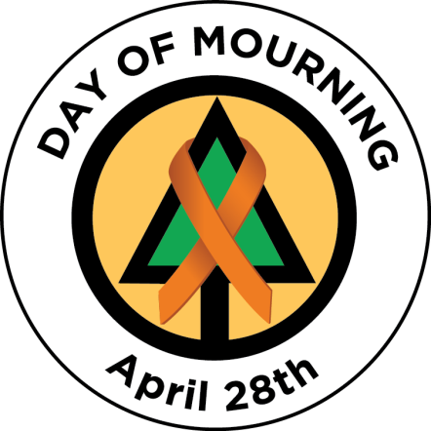
Day of Mourning Links
Day of Mourning website
www.dayofmourning.bc.ca
Canadian Center for Occupational Health and Safety
www.ccohs.ca/events/mourning
BC Forest Safety Council – Day of Mourning
www.bcforestsafe.org/resource/day-of-mourning-april-28th/

