Slide 1
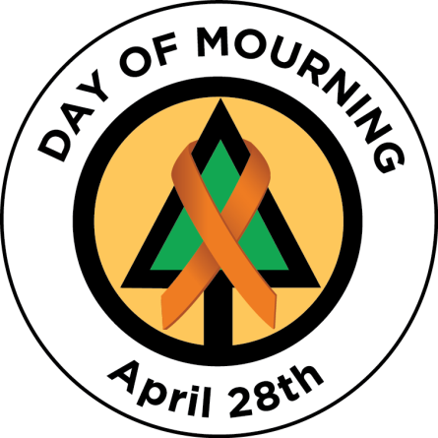

Slide 2
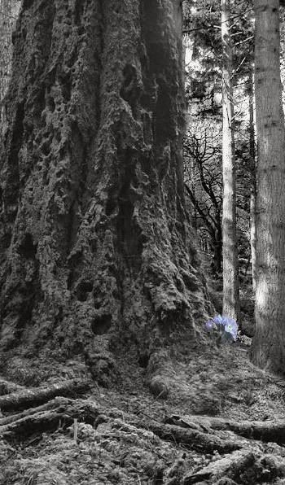
Day of Mourning – April 28
The “Day of Mourning” recognizes those who have lost their lives, were injured or made ill as a result of work-related incidents or occupational diseases and focusses on renewing our commitment to preventing further workplace tragedies.
HISTORY:
The Canadian Labour Congress initiated a National Day of Mourning ceremony on April 28, 1984 and ceremonies have been held across the country ever since. This day is now recognized around the world in more than 100 countries.
April 28th was chosen as it was this date, in 1914, the first Workers’ Compensation Act was brought into effect in Canada.

Slide 3
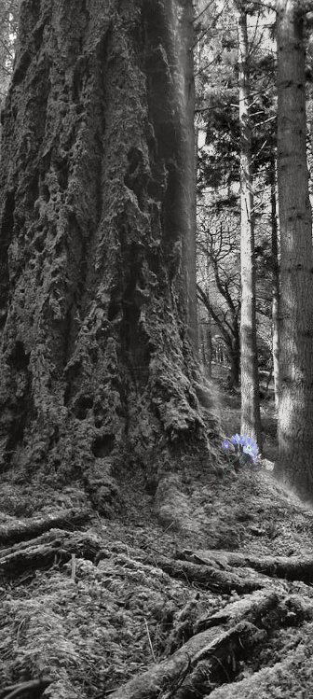
NATIONAL STATISTICS:
According to the Association of Workers’ Compensation Boards of Canada:
Every year, approximately 1,000 workers die in Canada.
Every day, nearly three workers die.
Every year, workers suffer from 250,000 work-related injuries/diseases.
Every day, workers suffer from 685 work-related injuries/diseases.
A compensable injury occurs every seven seconds of each working day.
BC STATISTICS:
In 2020, there were 151 workers in BC who lost their lives to workplace injury or disease.
BC FORESTRY INDUSTRY STATISTICS:
Since 2020 – there have been three harvesting fatalities in forestry. One in late 2020 and two in early 2021.

Slide 4
Forestry Operations
October 3, 2020: A silviculture worker missed their scheduled check-in. The employer initiated a search and the vehicle was found overturned down an embankment on a resource road. The worker was found to be deceased.
Fatality Alert – October 3, 2020
.

Slide 5
Forestry Operations
March 1, 2021: A hand faller was conducting road right-of-away falling in old-growth timber. The faller was struck and dragged downslope about 8.5 metres by a previously dead and down tree (no roots attached).
Fatality Alert - March 1, 2021
March 15, 2021: A manual tree faller was fatally injured when he was struck by the top of a Hemlock danger tree at a logging site near Port McNeil, BC.
Fatality Alert – March 15, 2021
.

Slide 6
Staying safe
We all play a role in keeping ourselves and our co-workers safe.
Take a moment to recognize how you can impact workplace safety:
Report unsafe acts or conditions - don’t ignore it or think someone else will do it.
Be prepared for work – mentally and physically. Recognize when you are fatigued, rushed, distracted or complacent and may be making unsafe decisions. Stop and re-assess what you are about to do.
Take an active role in your crew members well-being. If a co-worker is distracted or otherwise unfit for work, talk to them or your supervisor. An injured worker impacts us all.
Ask for assistance – talk to your supervisor if you are unsure of how to proceed or need additional support.

Slide 7
I Chose to Look The Other Way
By Don Merrell
I could have saved a life that day,
But I chose to look the other way.
It wasn't that I didn't care,
I had the time, and I was there.
But I didn't want to seem a fool,
Or argue over a safety rule.
I knew he'd done the job before,
If I spoke up, he might get sore.
The chances didn't seem that bad,
I'd done the same, He knew I had.
So I shook my head and walked on by,
He knew the risks as well as I.
He took the chance, I closed an eye,
And with that act, I let him die.
I could have saved a life that day,
But I chose to look the other way.
Now every time I see his wife,
I'll know, I should have saved his life.
That guilt is something I must bear,
But it isn't something you need share.
If you see a risk that others take,
That puts their health or life at stake.
The question asked, or thing you say,
Could help them live another day.
If you see a risk and walk away,
Then hope you never have to say,
I could have saved a life that day,
But I chose, to look the other way.

Slide 8
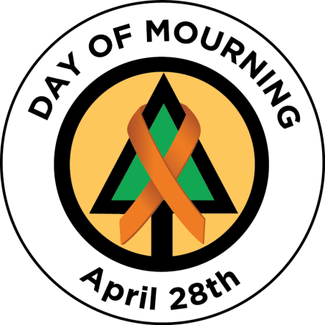
Day of Mourning links
Day of Mourning website
www.dayofmourning.bc.ca
Canadian Center for Occupational Health and Safety
www.ccohs.ca/events/mourning
BC Forest Safety Council
www.bcforestsafe.org

